Slide 1
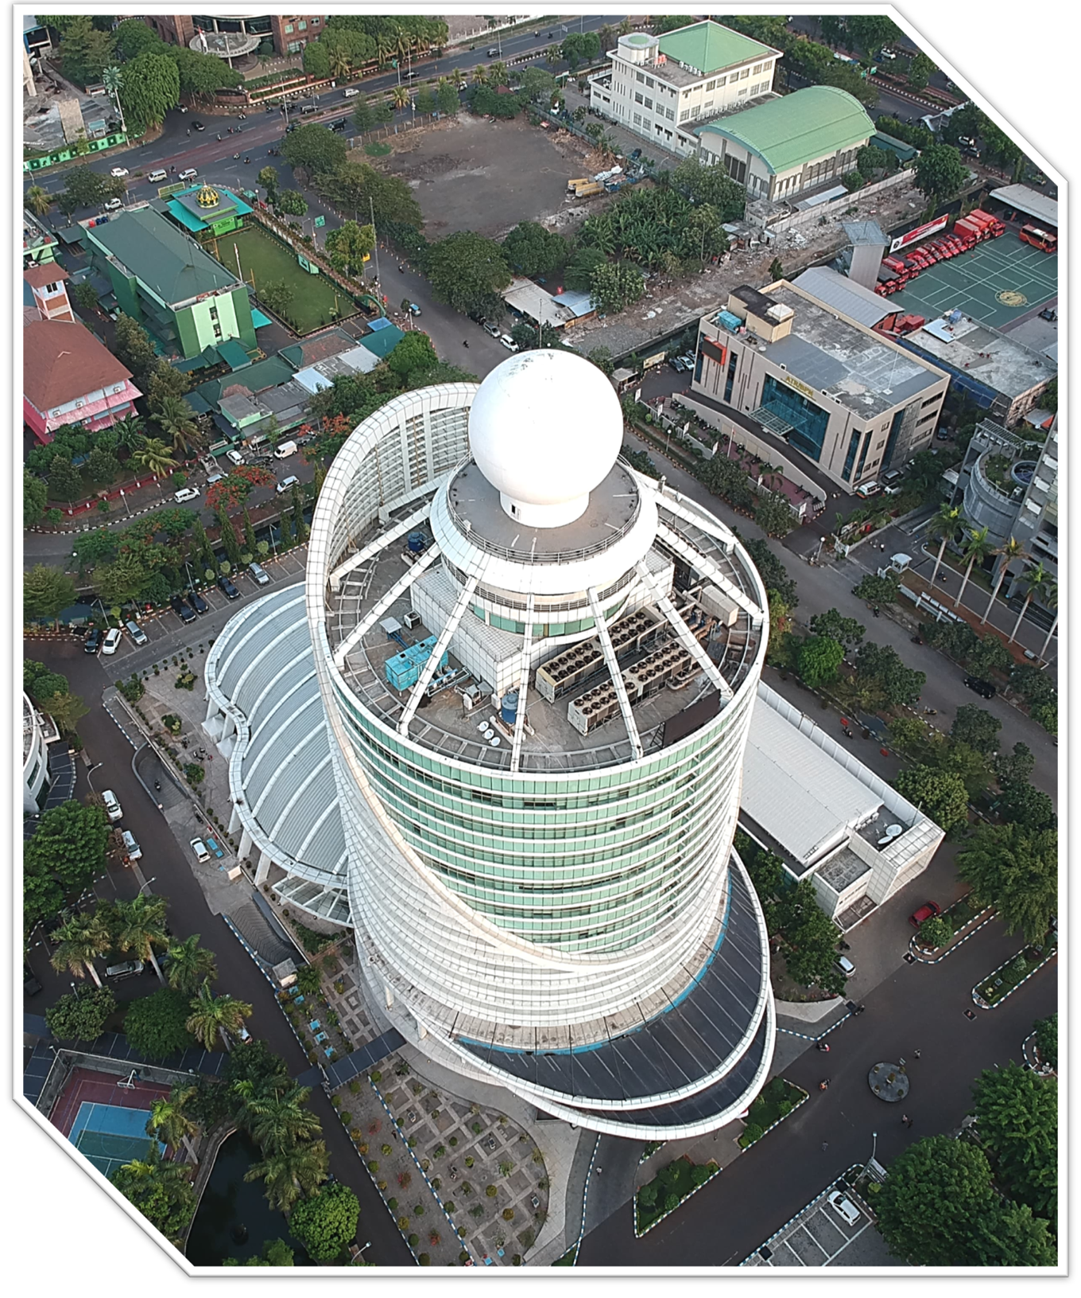

BADAN METEOROLOGI
KLIMATOLOGI DAN GEOFISIKA
BRIEFING
KONDISI CUACA
05 April 2026
Kedeputian Bidang Meteorologi

Slide 2
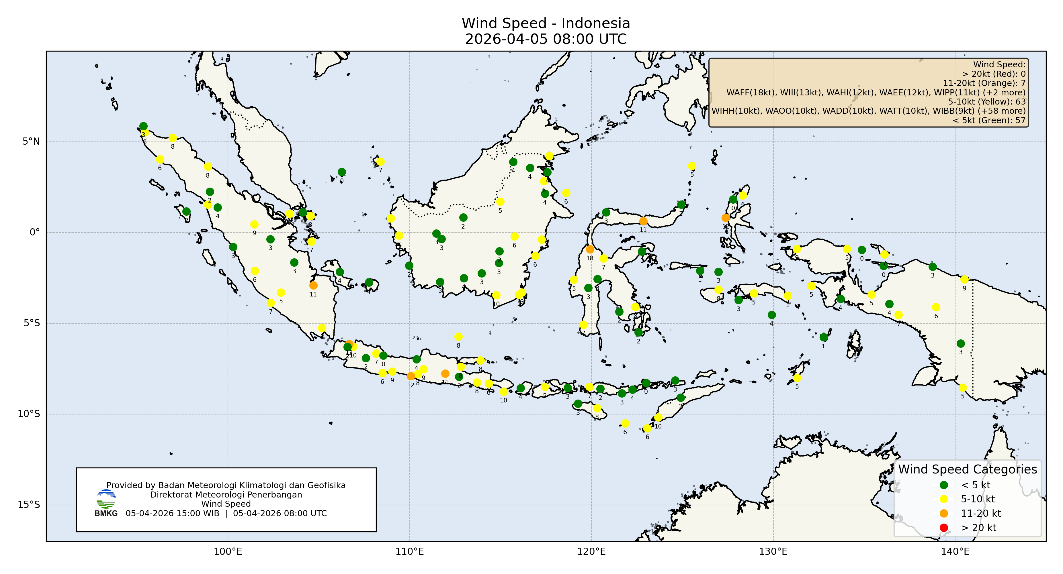
Distribusi Kecepatan Angin (METAR)

Slide 3
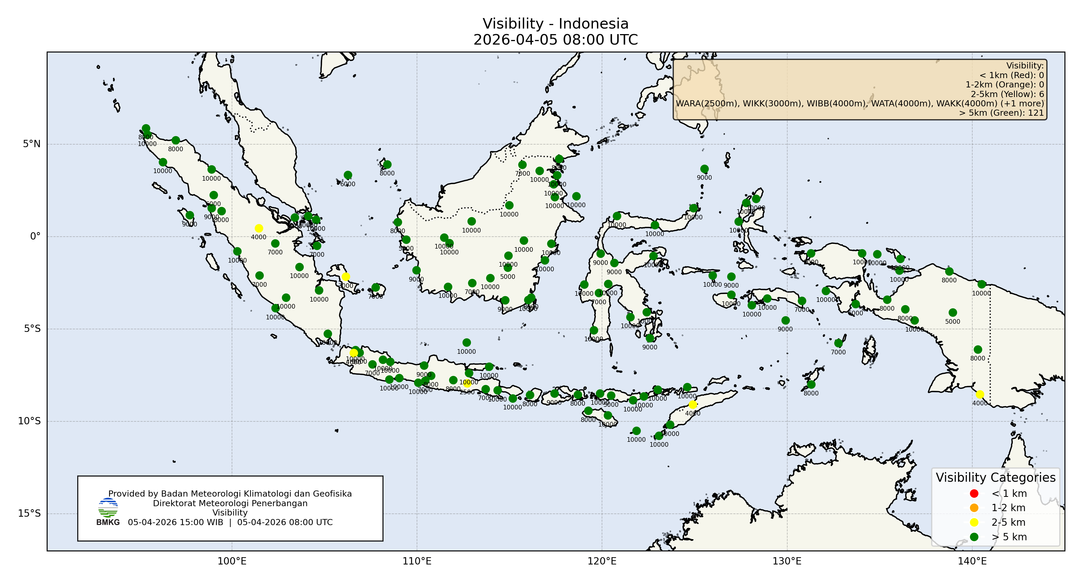
Distribusi Jarak Pandang (METAR)

Slide 4
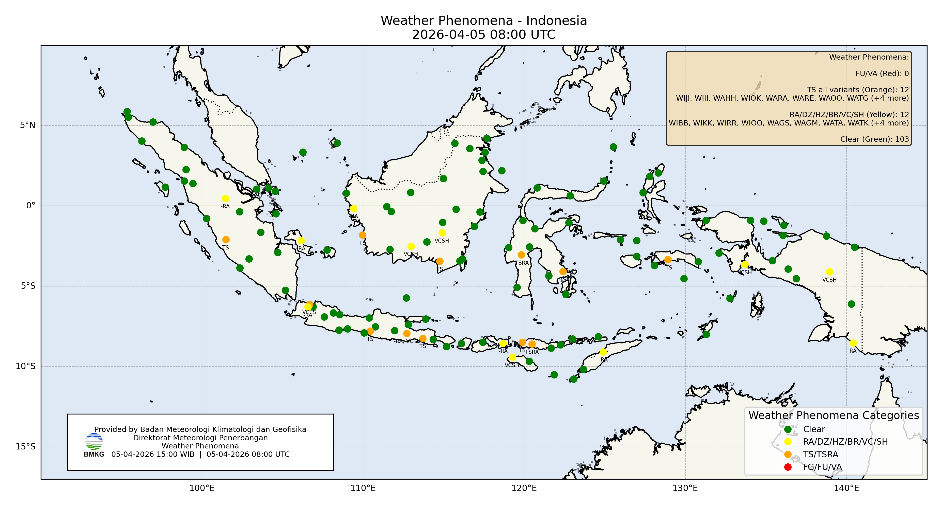
Distribusi Fenomena Cuaca (METAR)

Slide 5
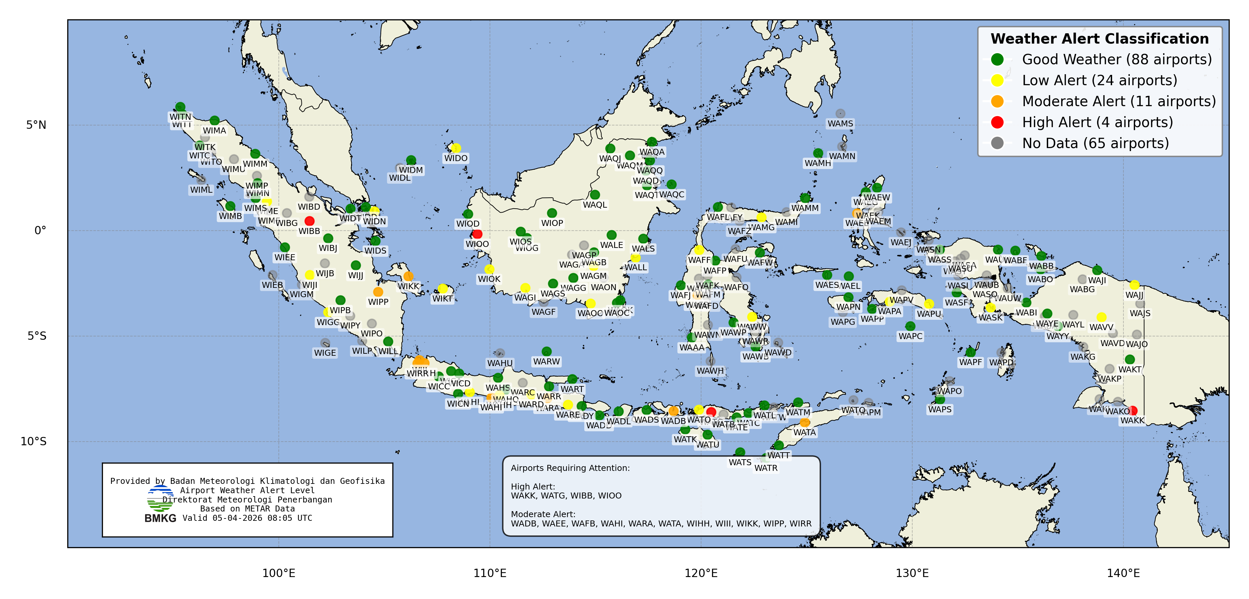
Distribusi Tingkat Kewaspadaan
berdasarkan Observasi (METAR)

Slide 6
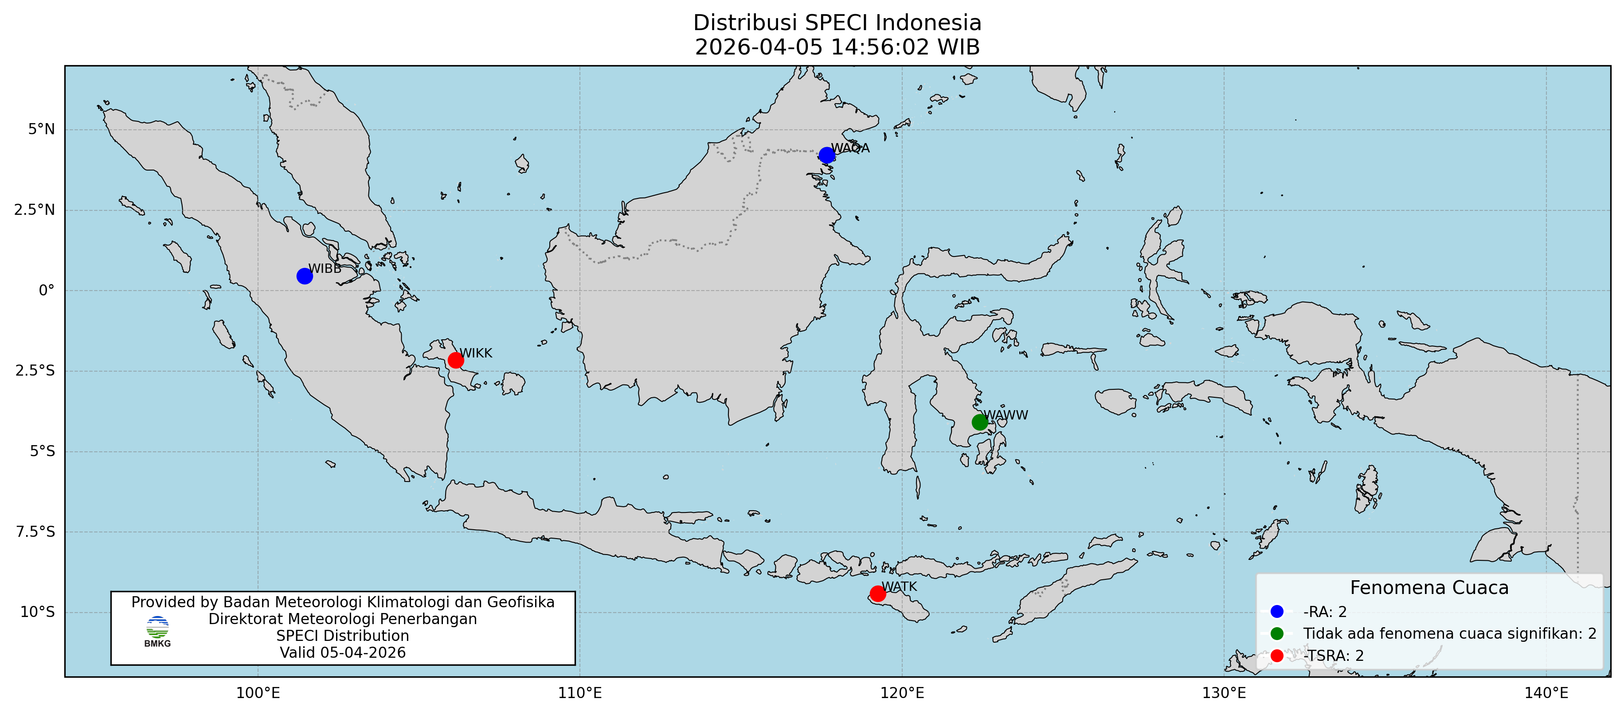
SPECI 05 April 2025

Slide 7
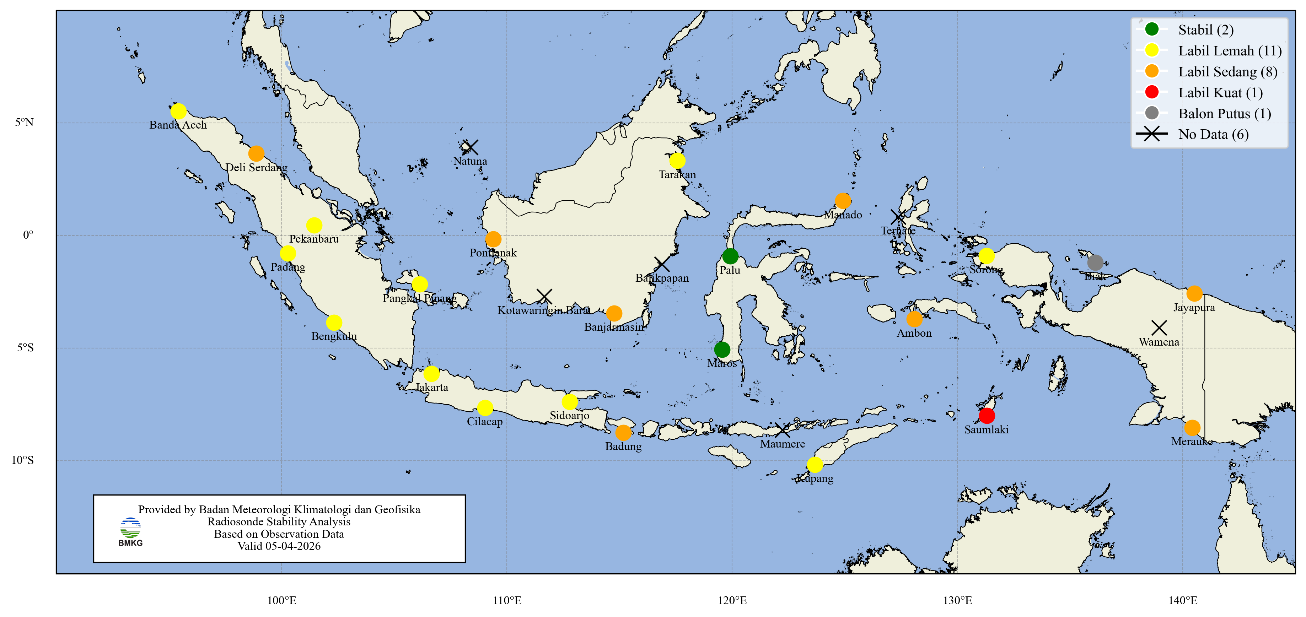
Analisis Udara Atas
05 April 2026 00.00 UTC

Slide 8
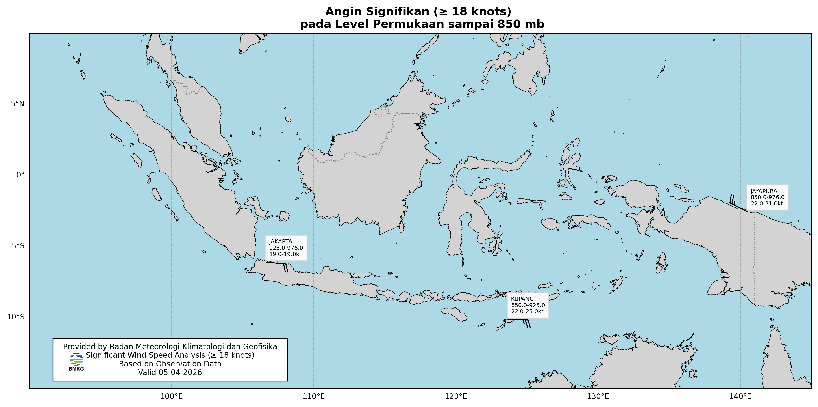
Angin Signifikan
05 April 2026 00.00 UTC

Slide 9
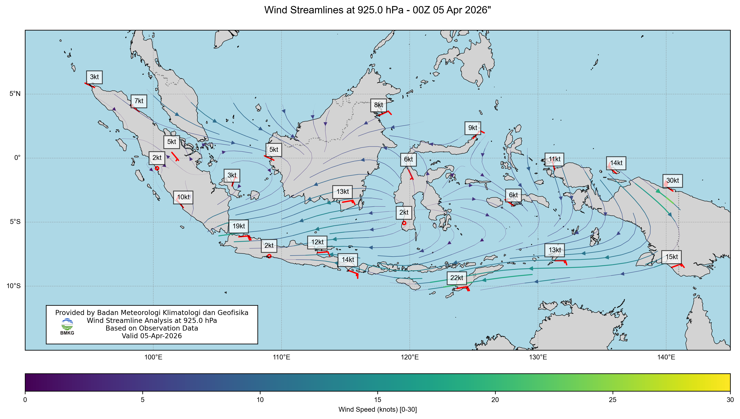
Streamline 925 mb Wind 05 April 2026, 00 UTC

Slide 10
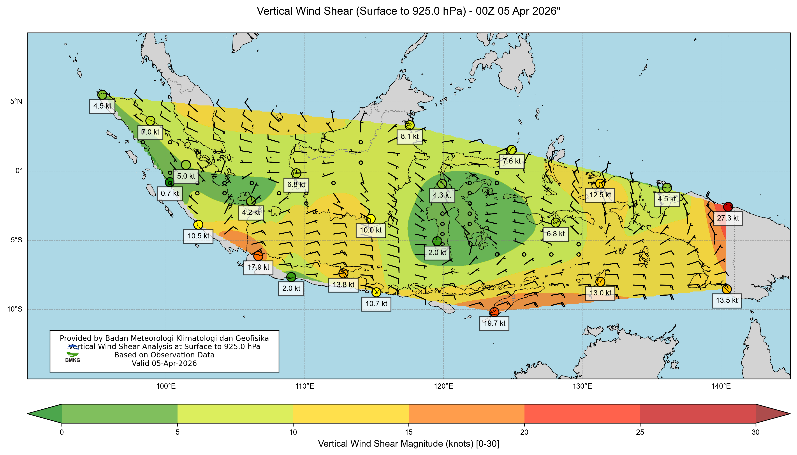
Vertical Wind Shear Sfc - 925 hPa 05 April 2026, 00 UTC

Slide 11
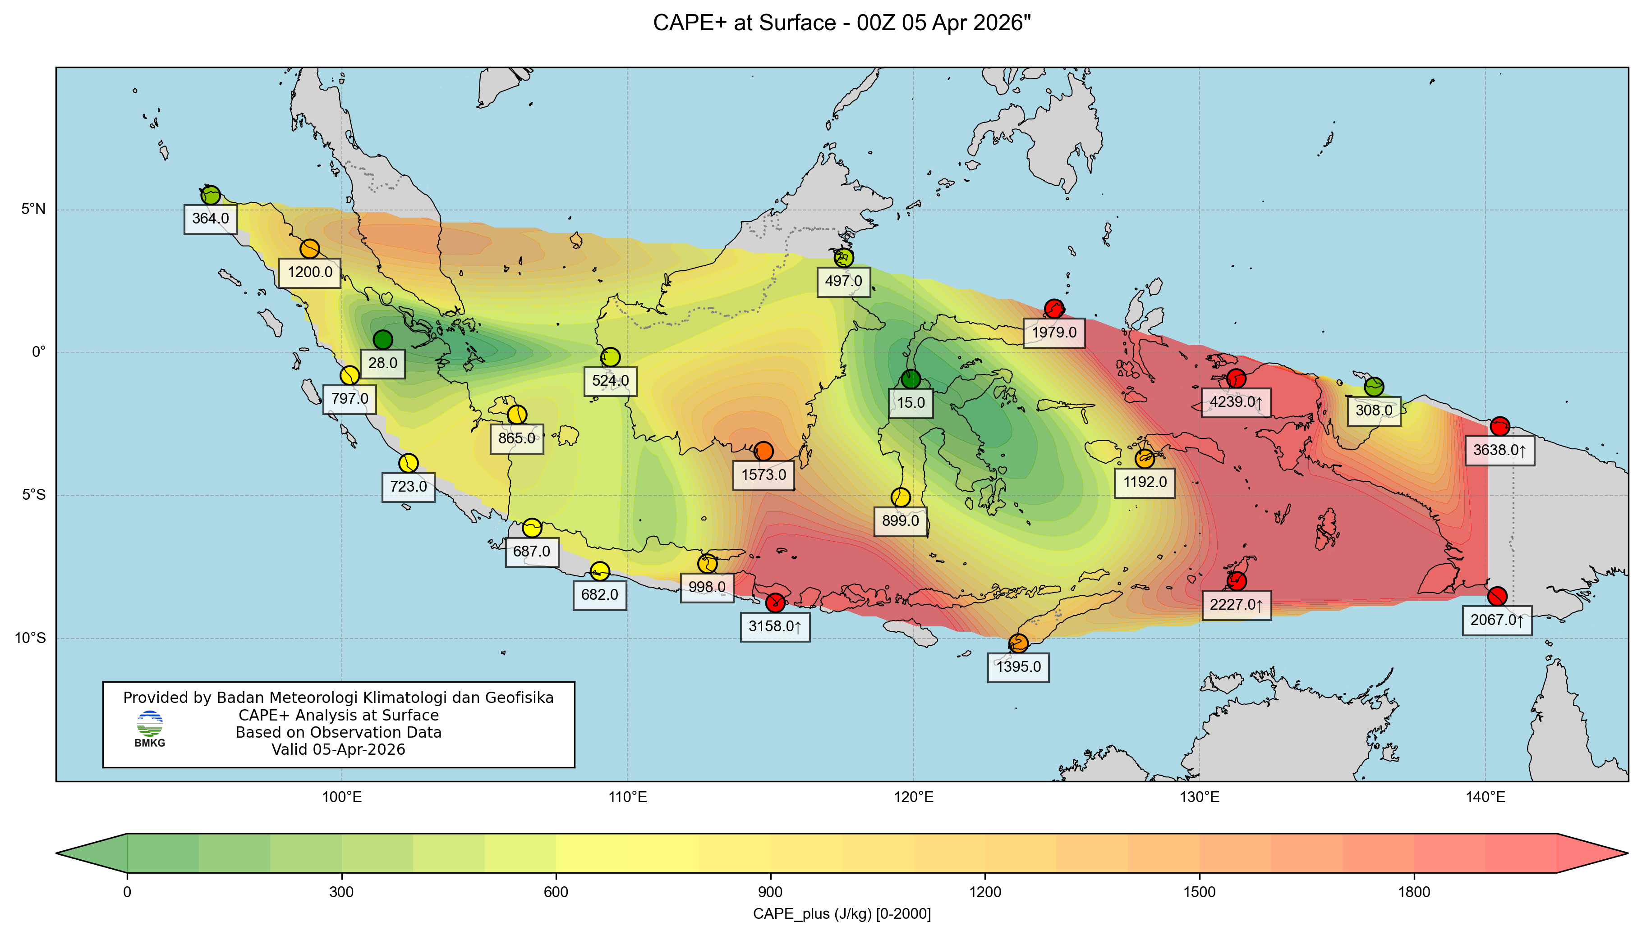
CAPE 05 April 2025, 00 UTC

Slide 12
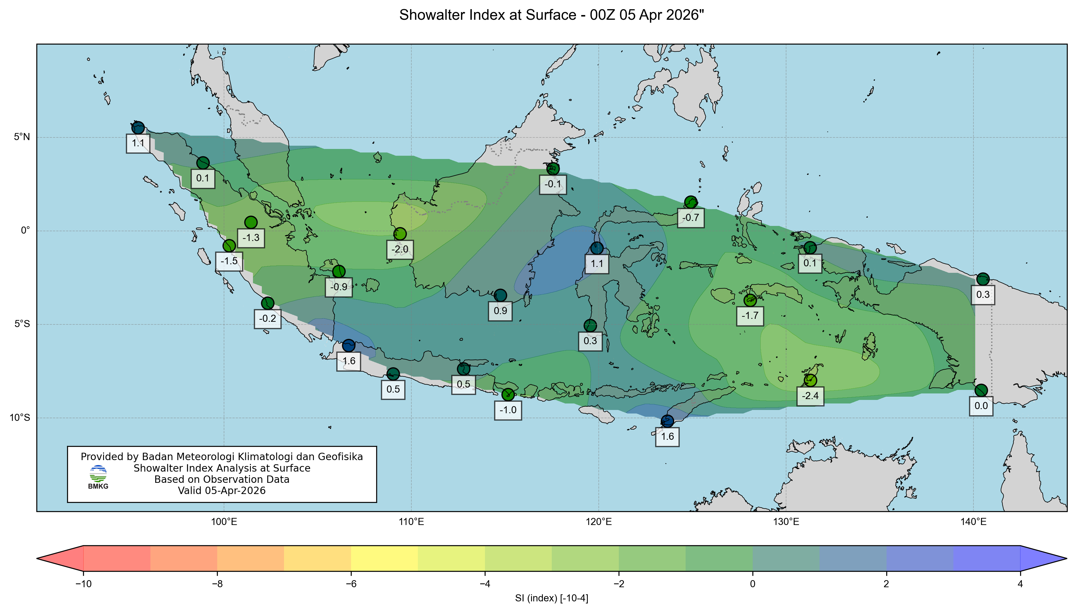
SI 05 April 2025, 00 UTC

Slide 13
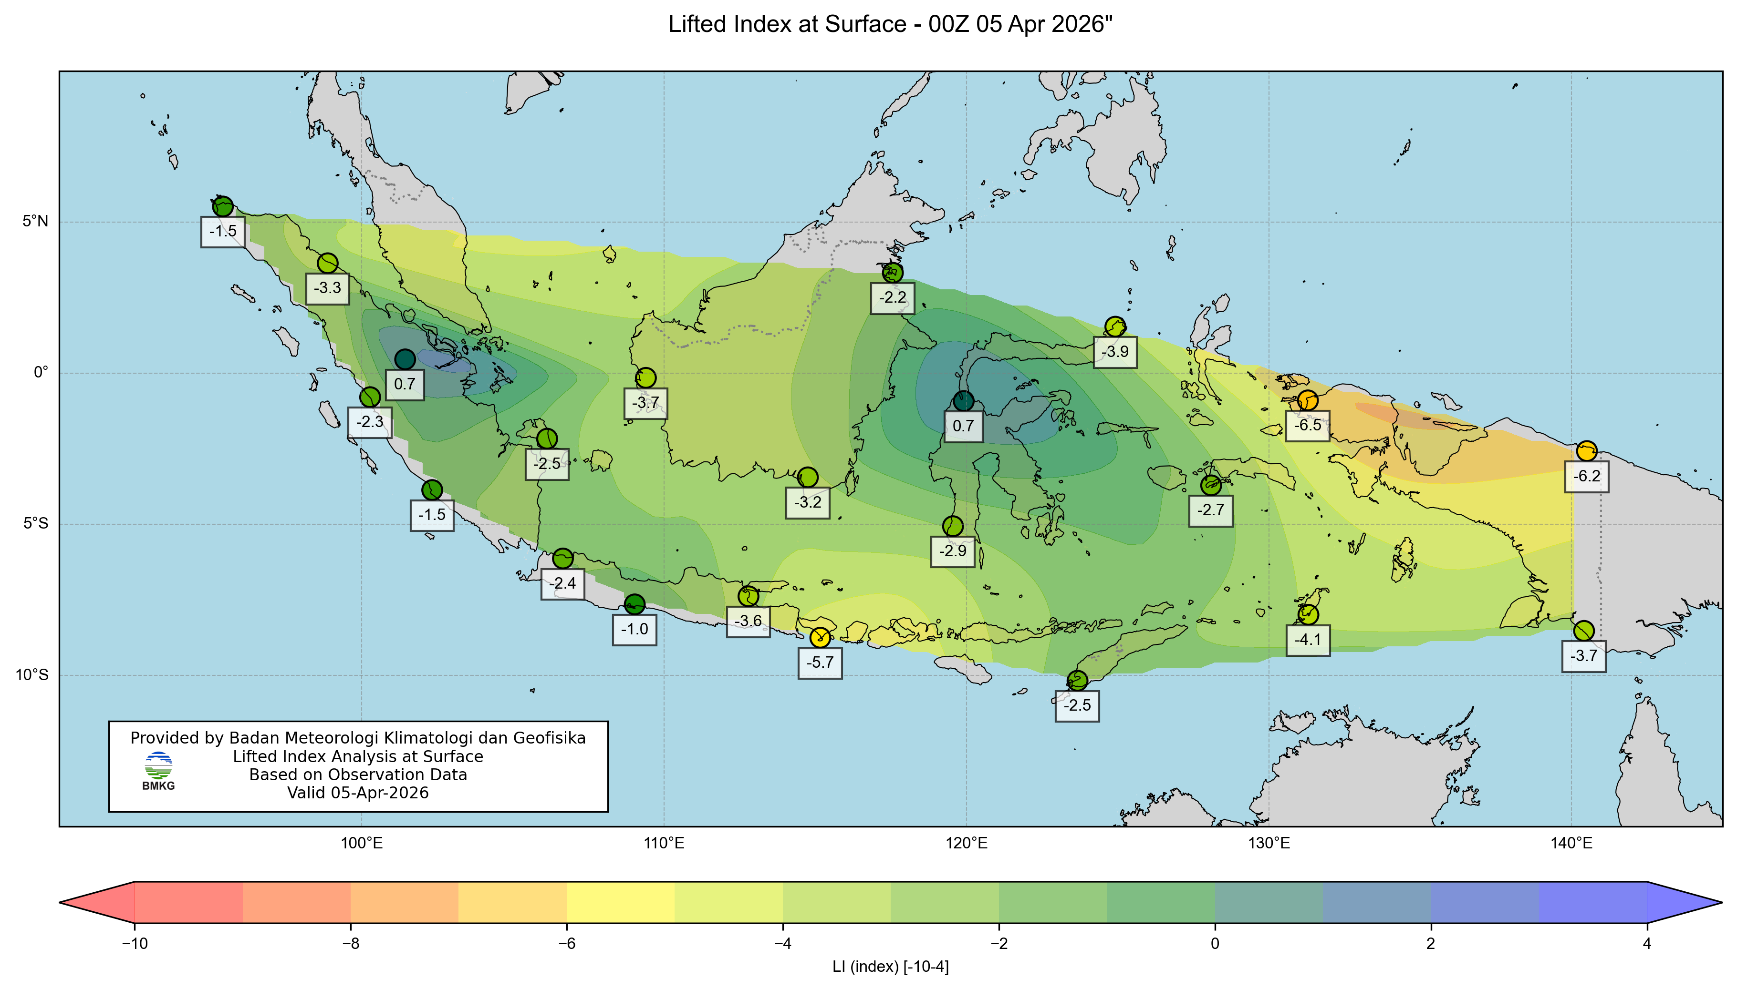
LI 05 April 2025, 00 UTC

Slide 14
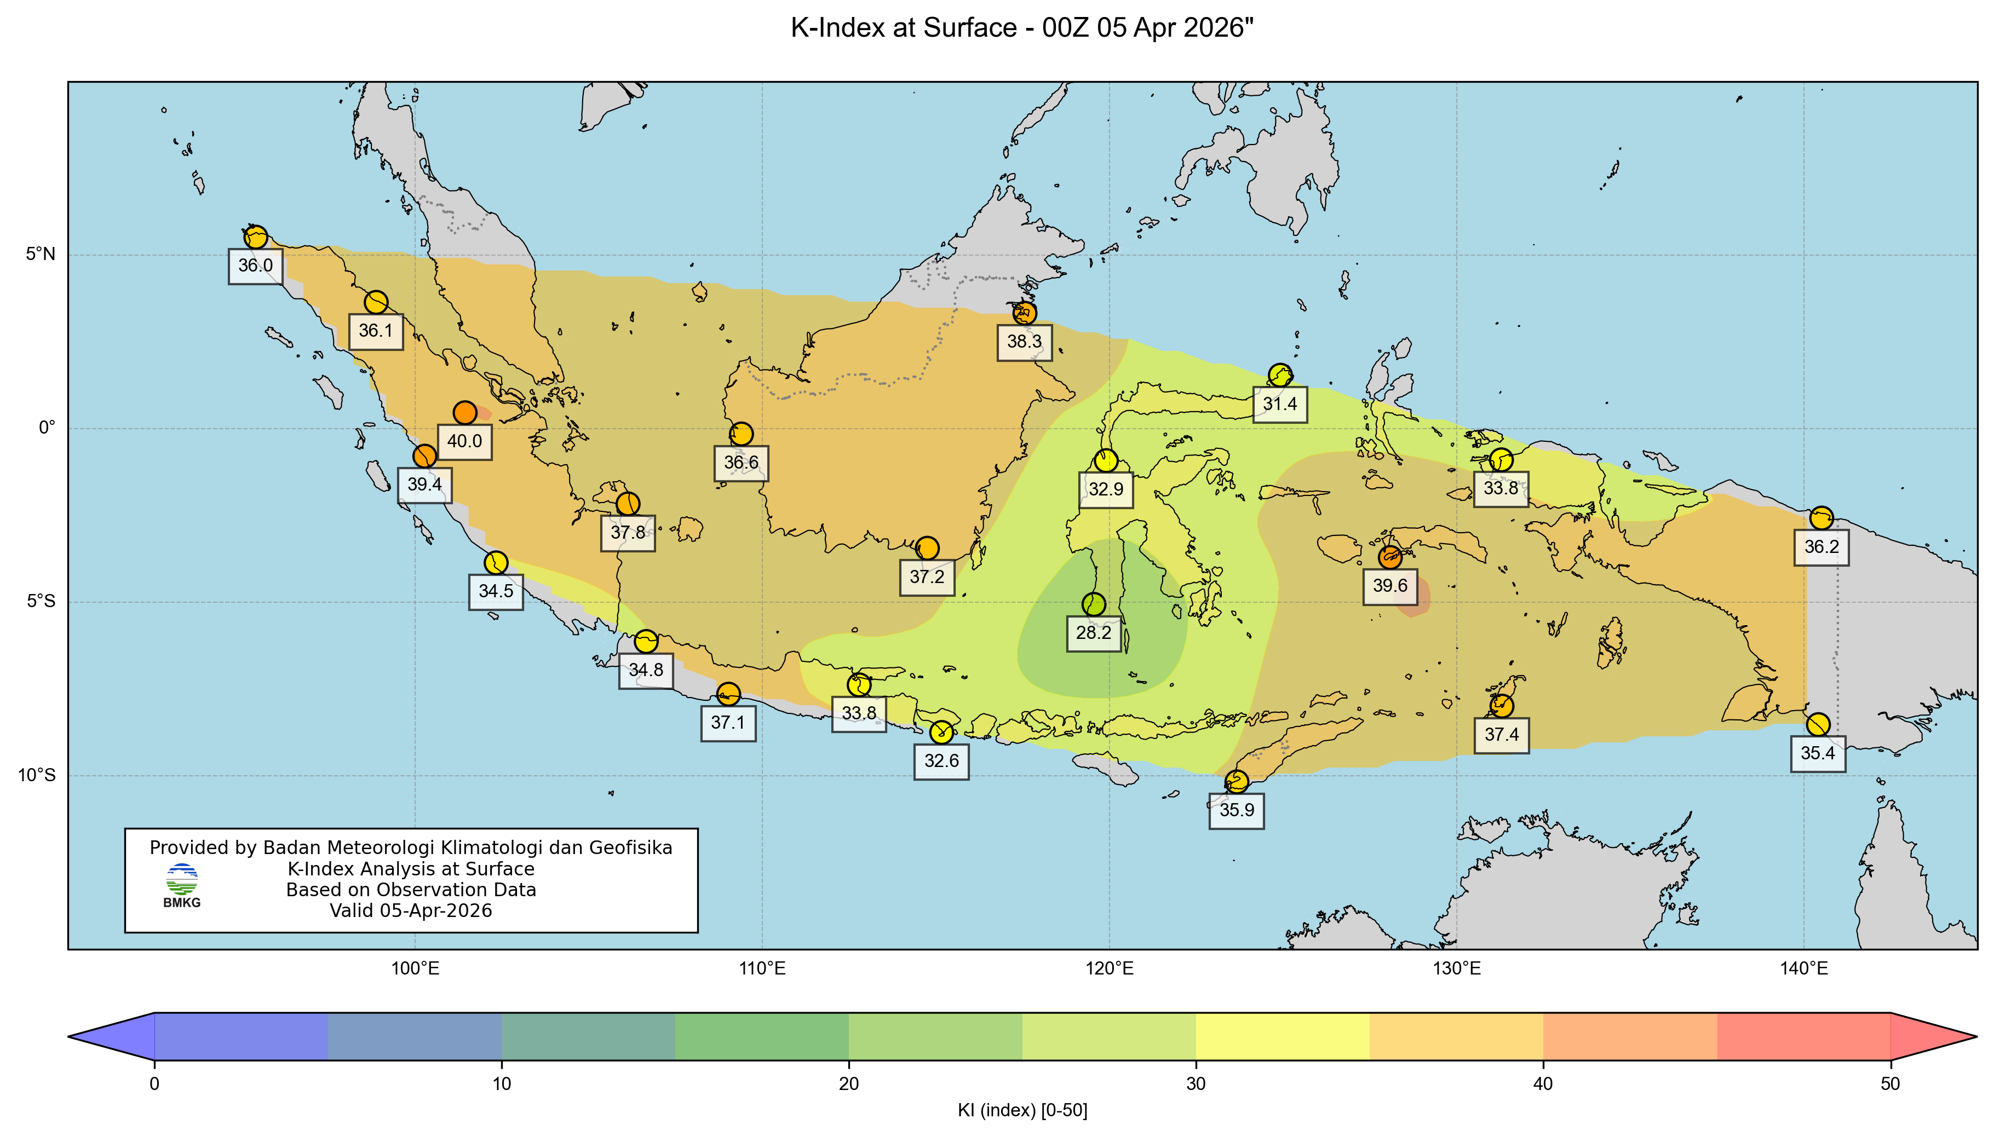
KI 05 April 2025, 00 UTC

Slide 15
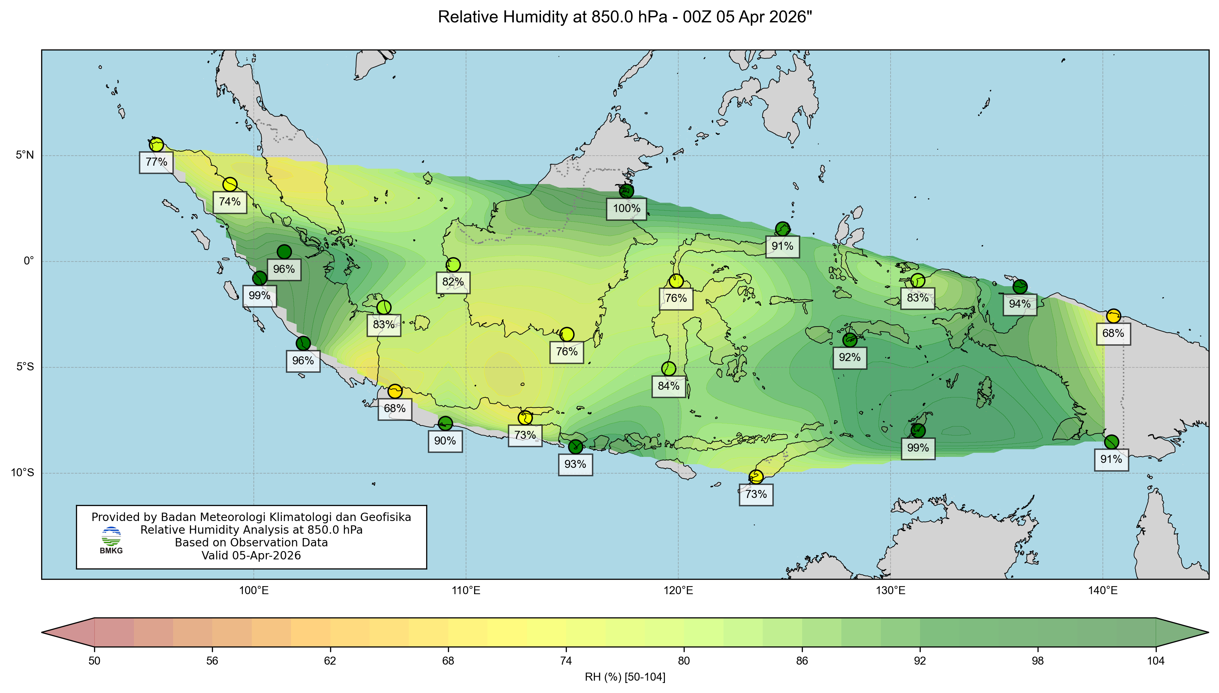
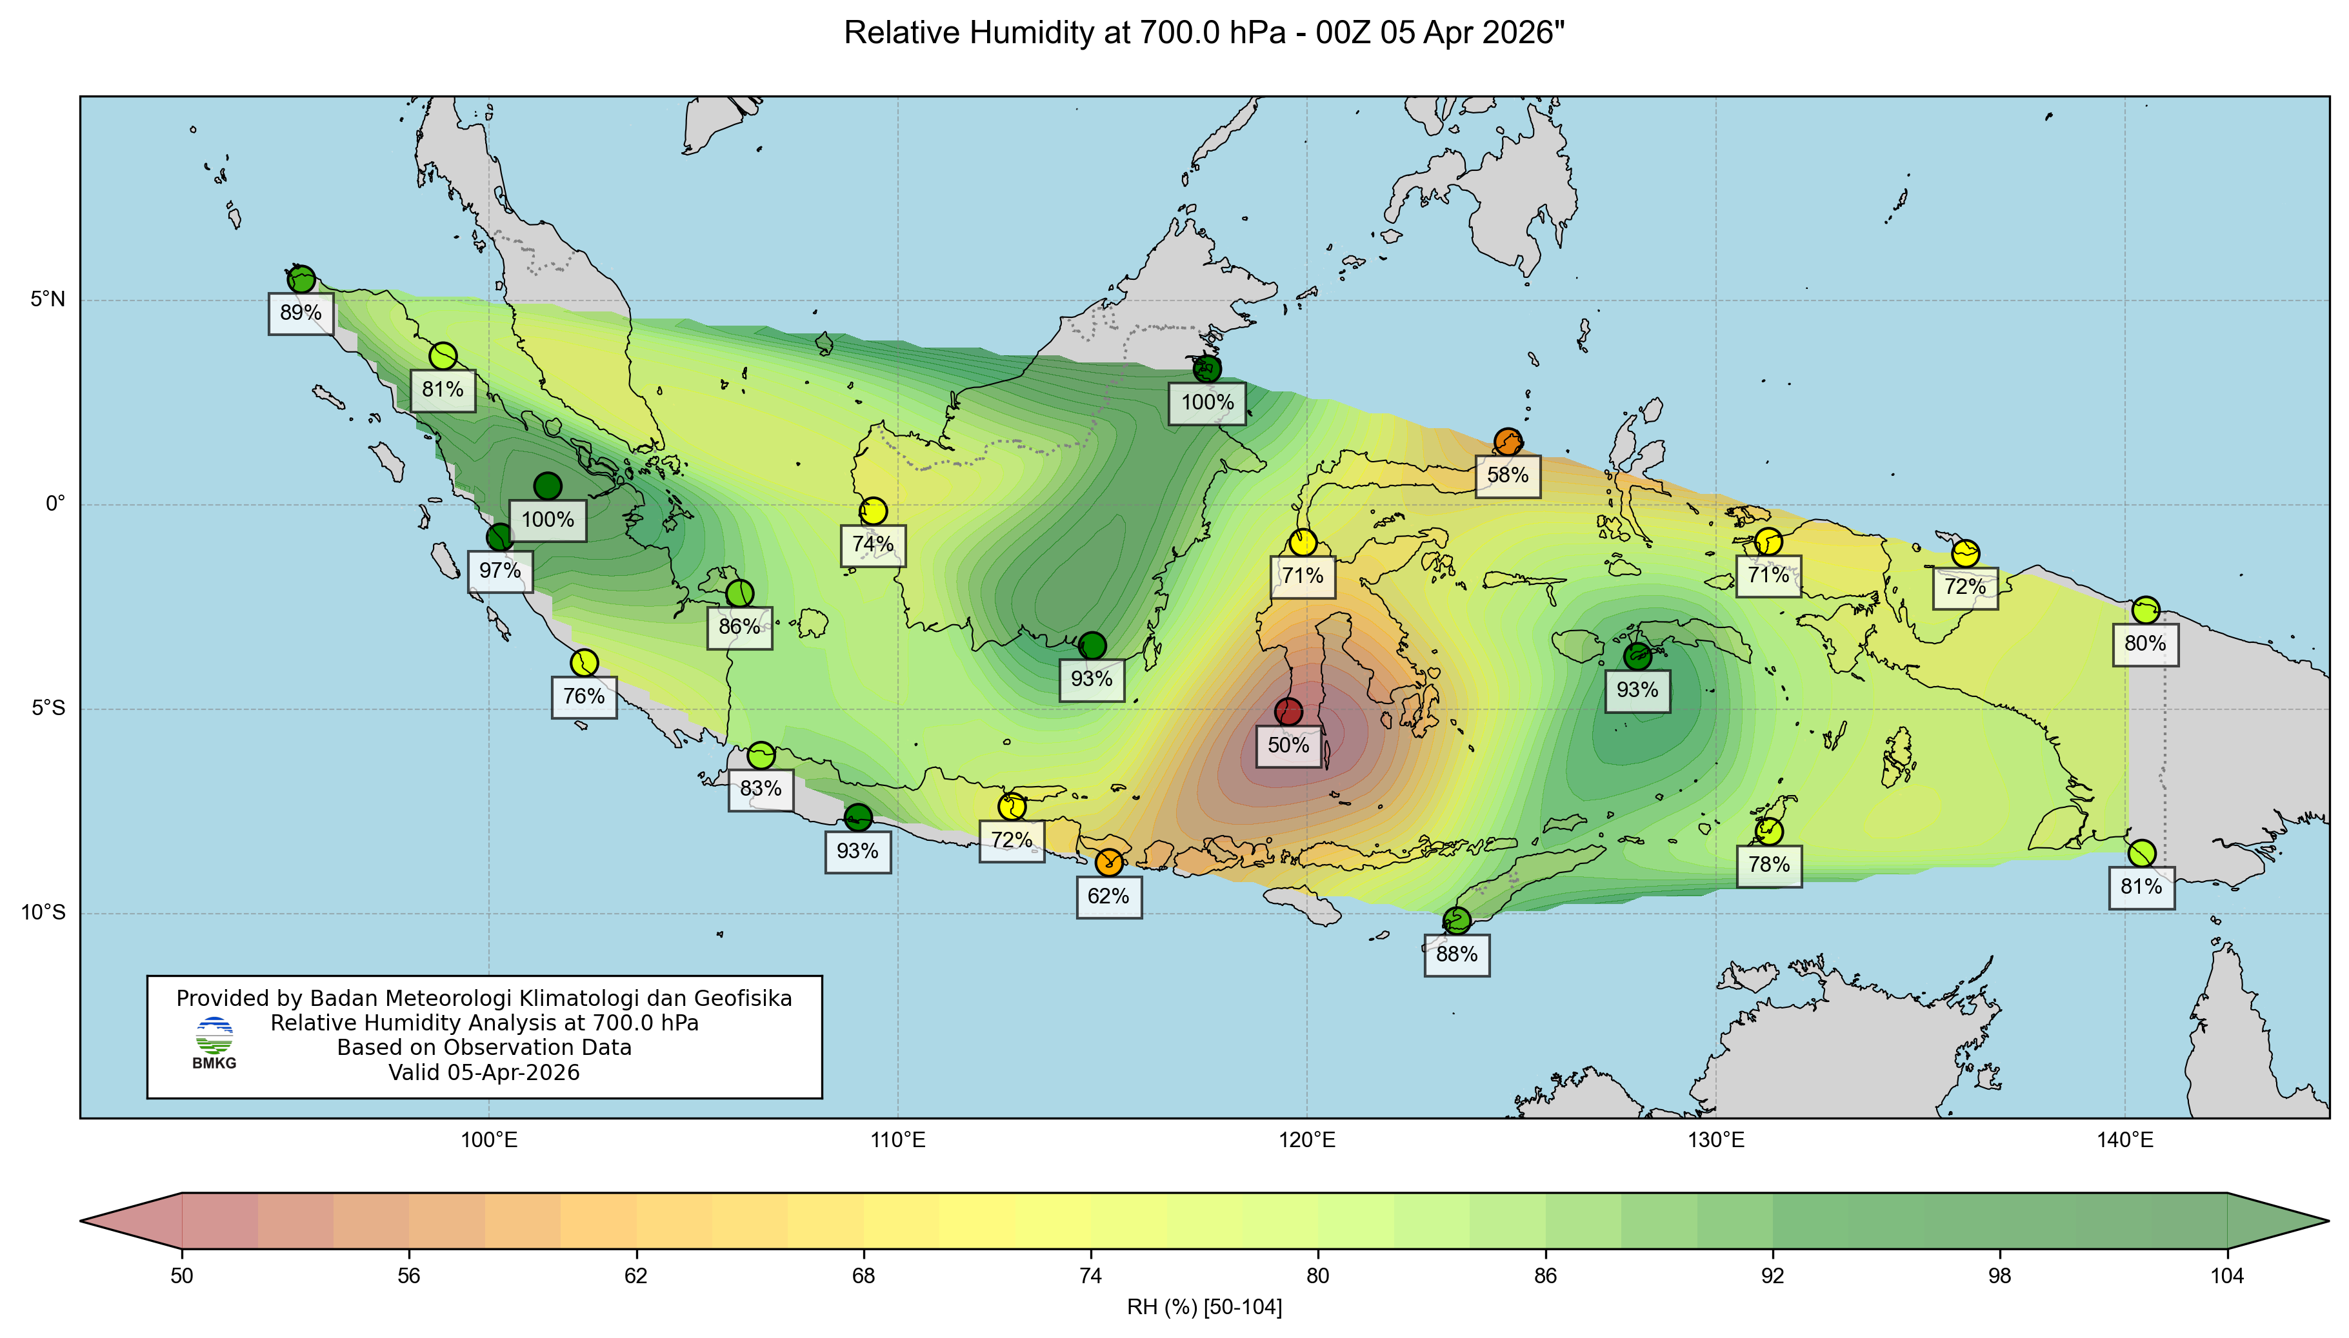
RH 850mb dan 700mb 05 April 2025, 00 UTC

Slide 16
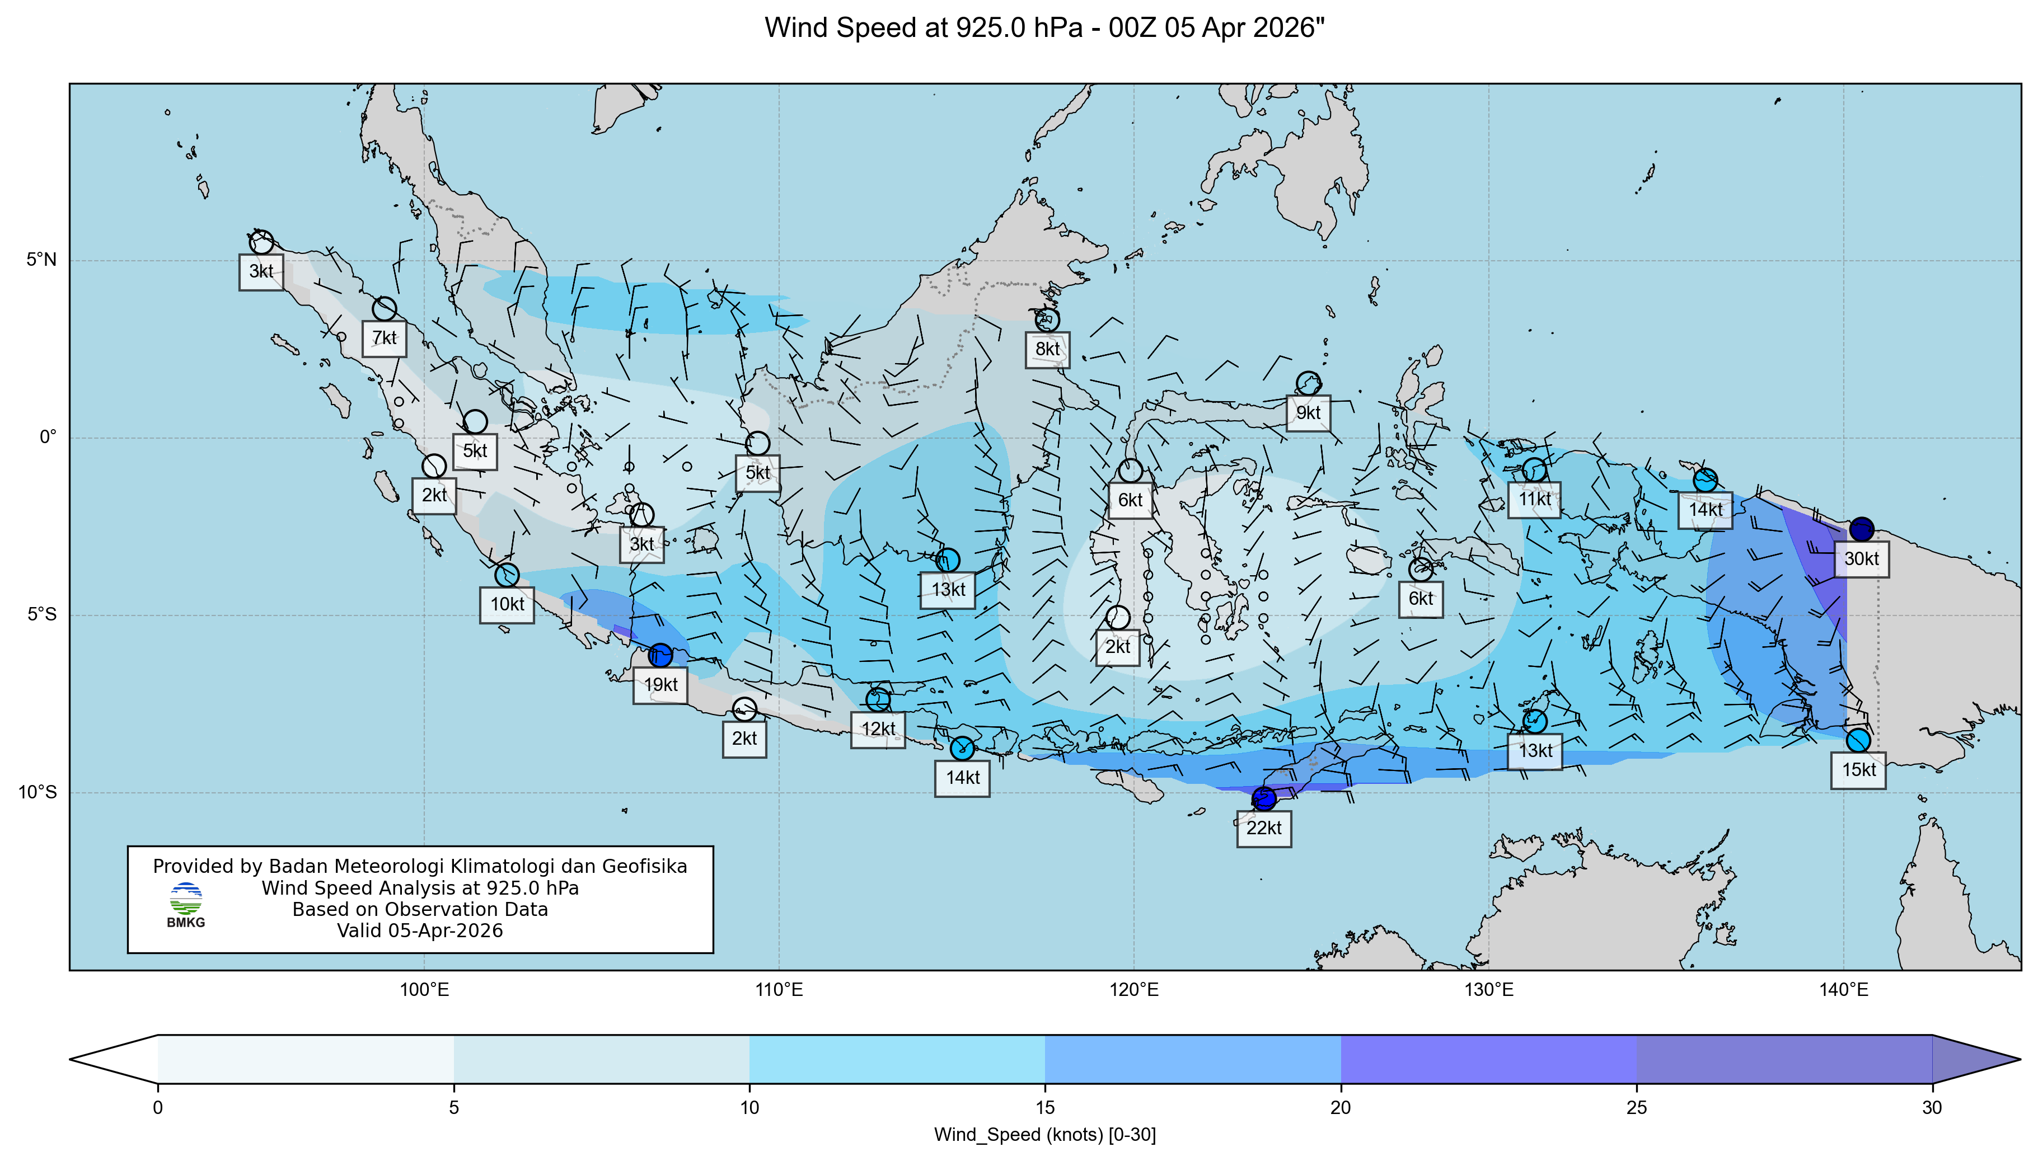
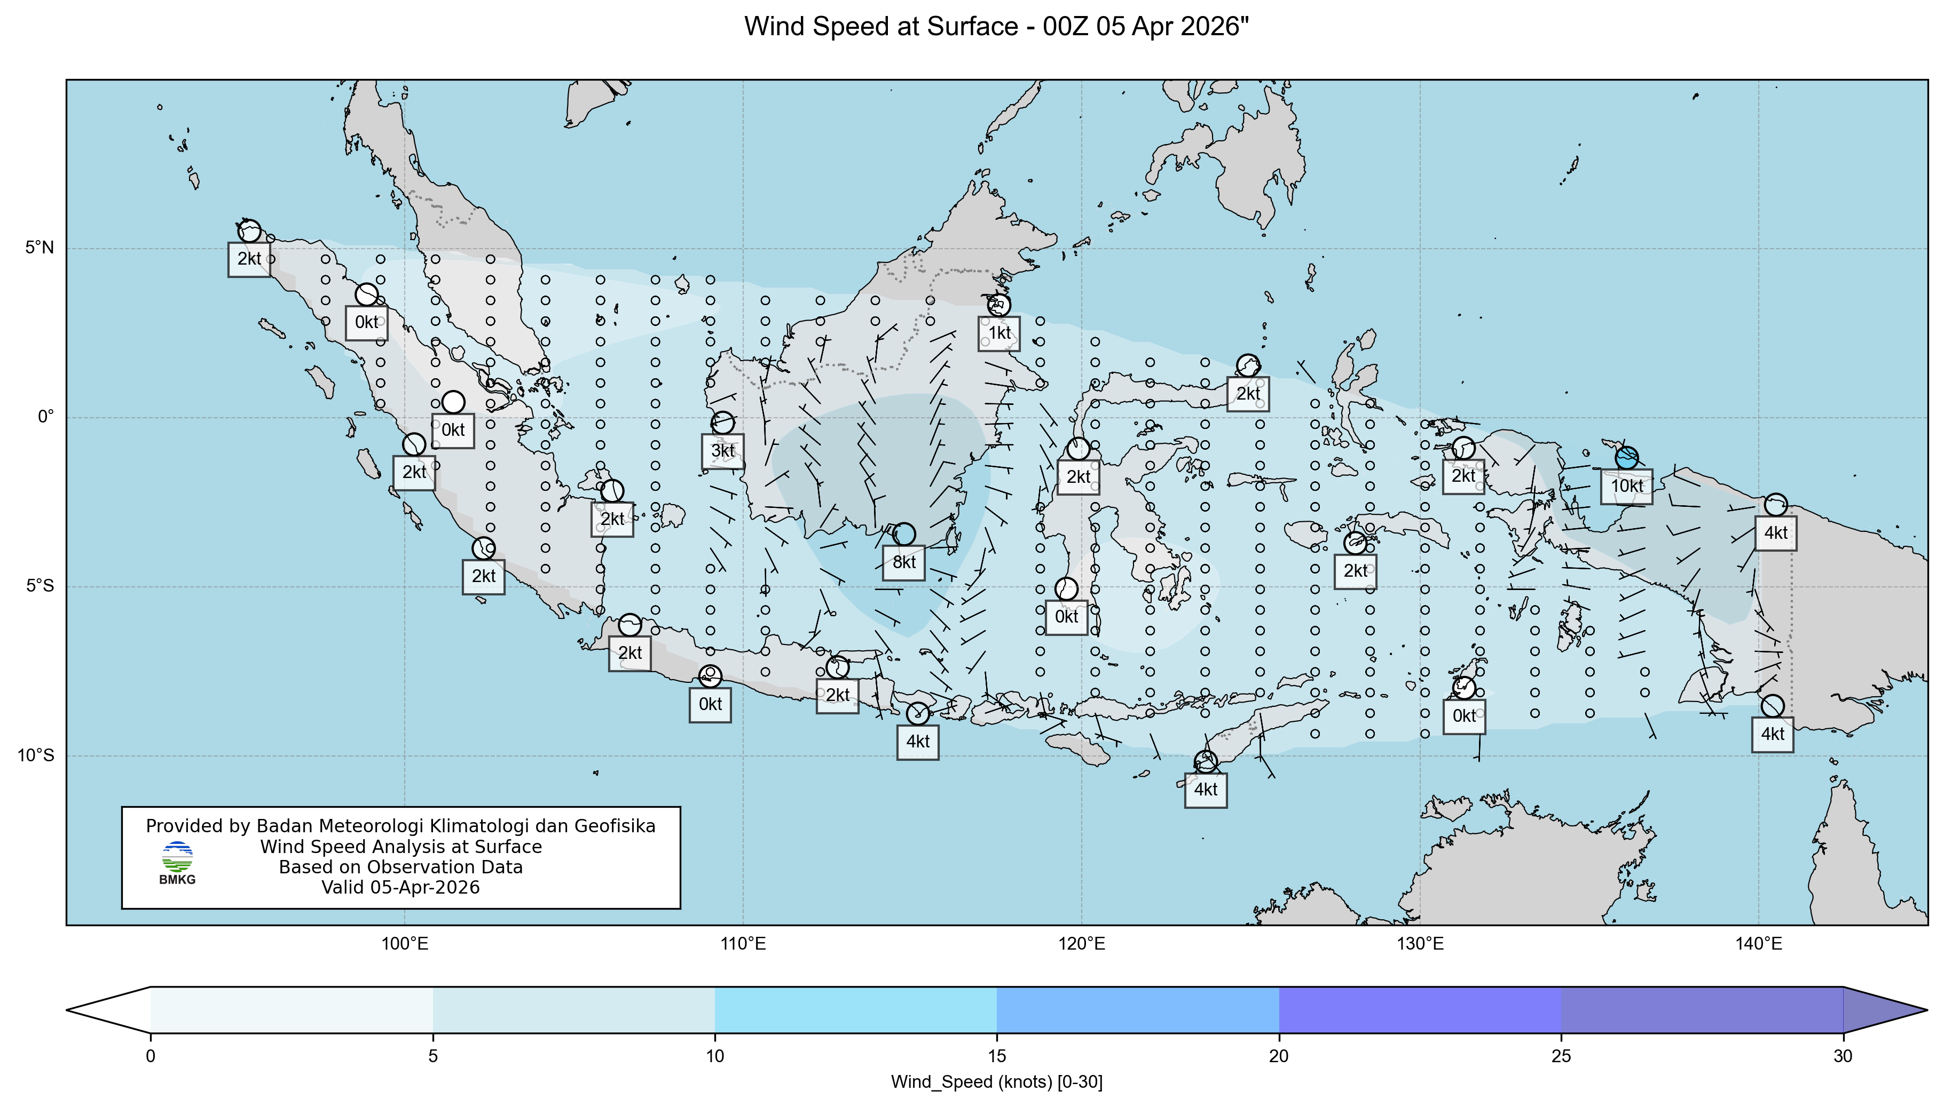
Surface - 925 mb Wind 05 April 2025, 00 UTC

Slide 17
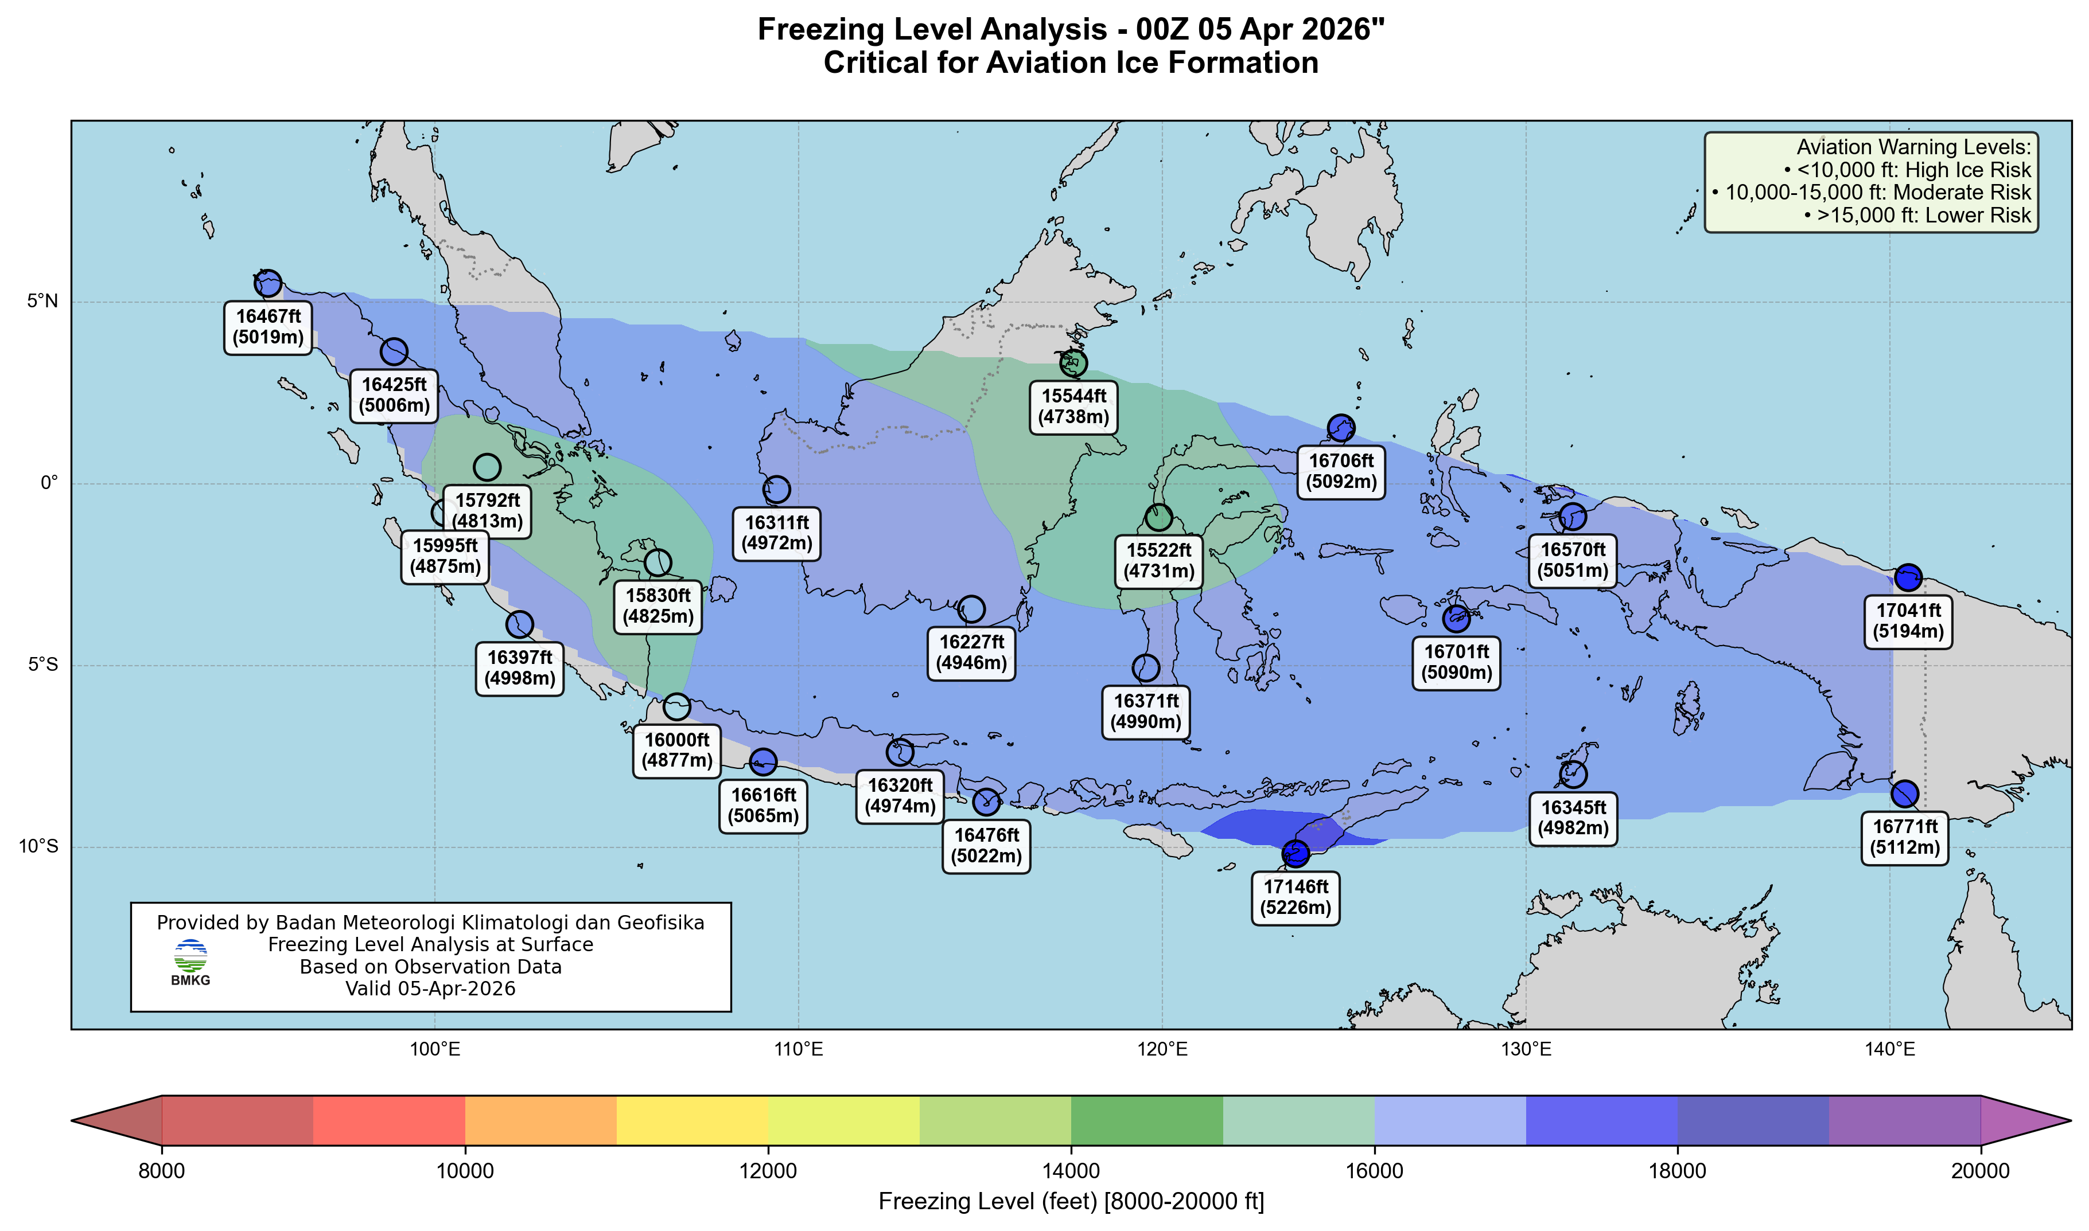
Freezing Level 05 April 2025, 00 UTC

Slide 18
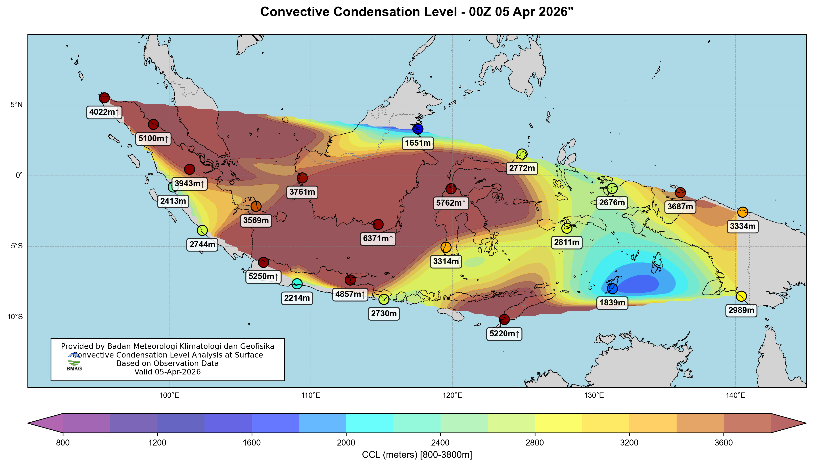
CCL 05 April 2026, 00 UTC

Slide 19
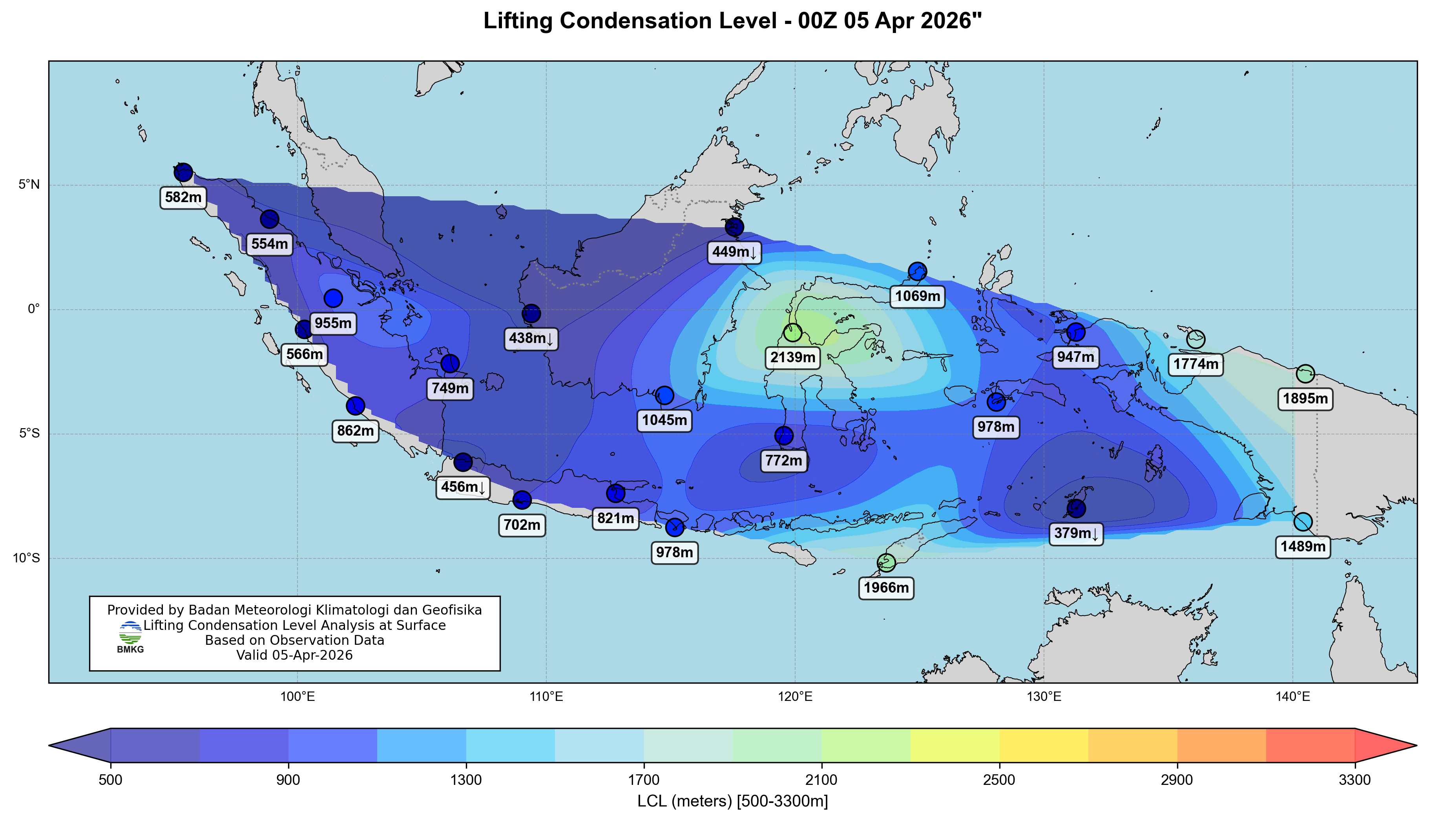
LCL 05 April 2026, 00 UTC

Slide 20
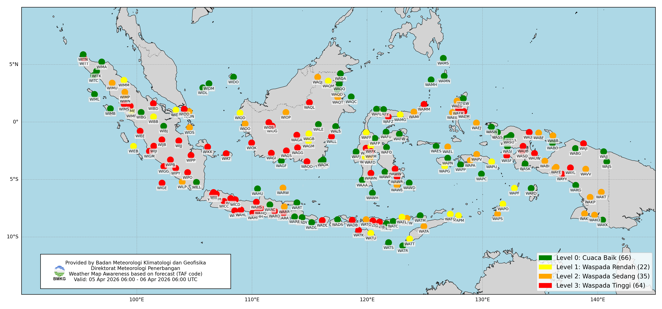
Distribusi Tingkat Kewaspadaan
berdasarkan Prakiraan (TAF)

Slide 21
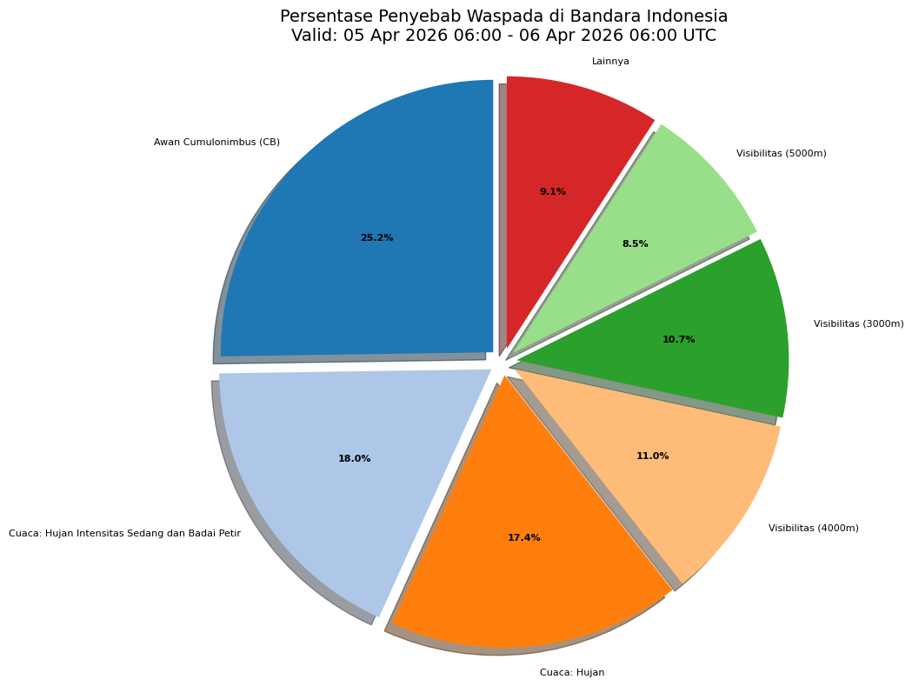
Penyebab Tingkat Kewaspadaan
berdasarkan Prakiraan (TAF)

Slide 22
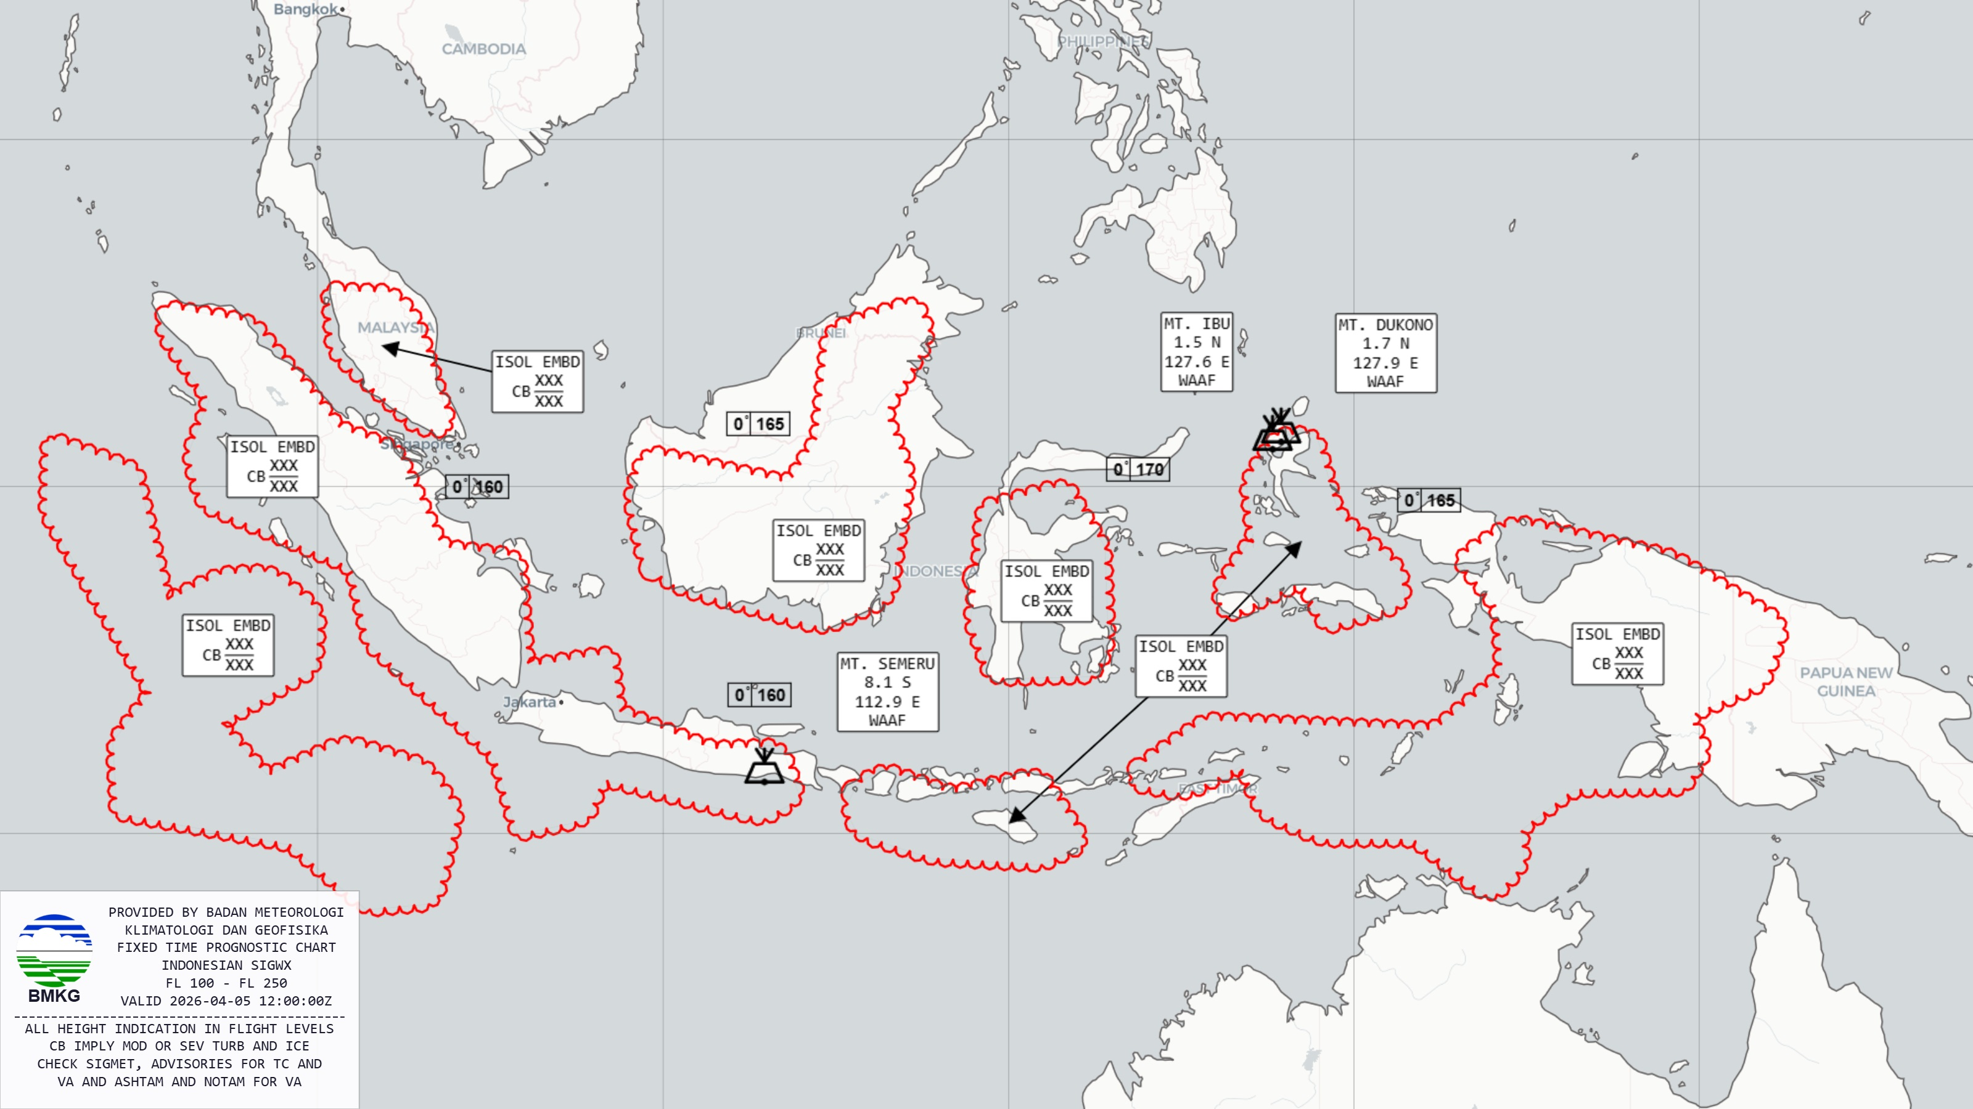
Medium Level SigWx 21 November 2025, 12 UTC

Slide 23
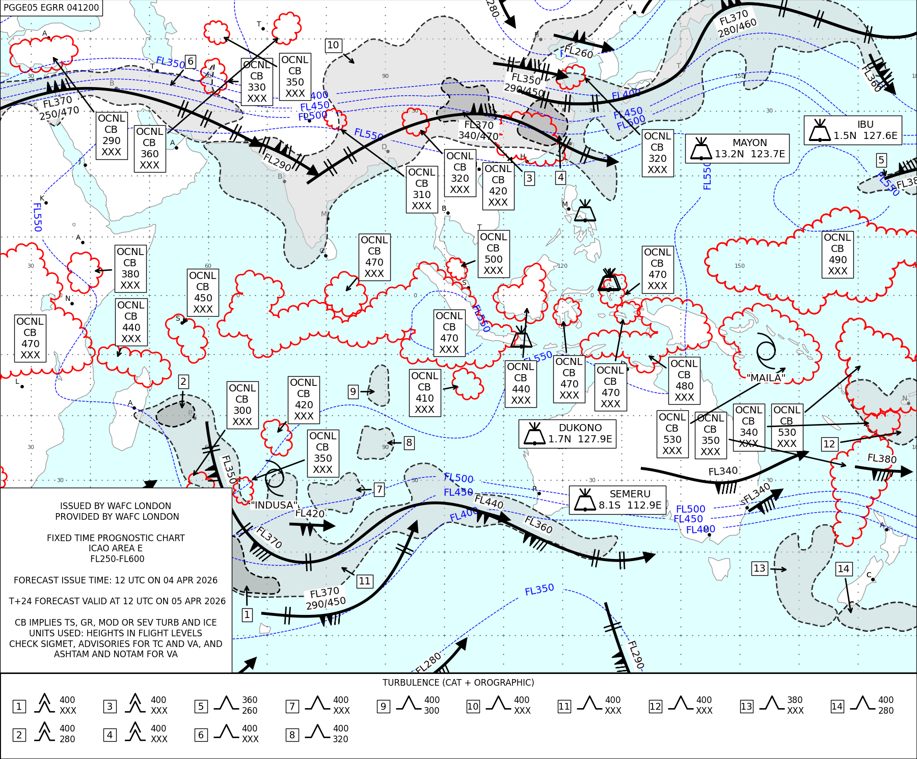
High Level SigWx 21 November 2025, 12 UTC

Slide 24
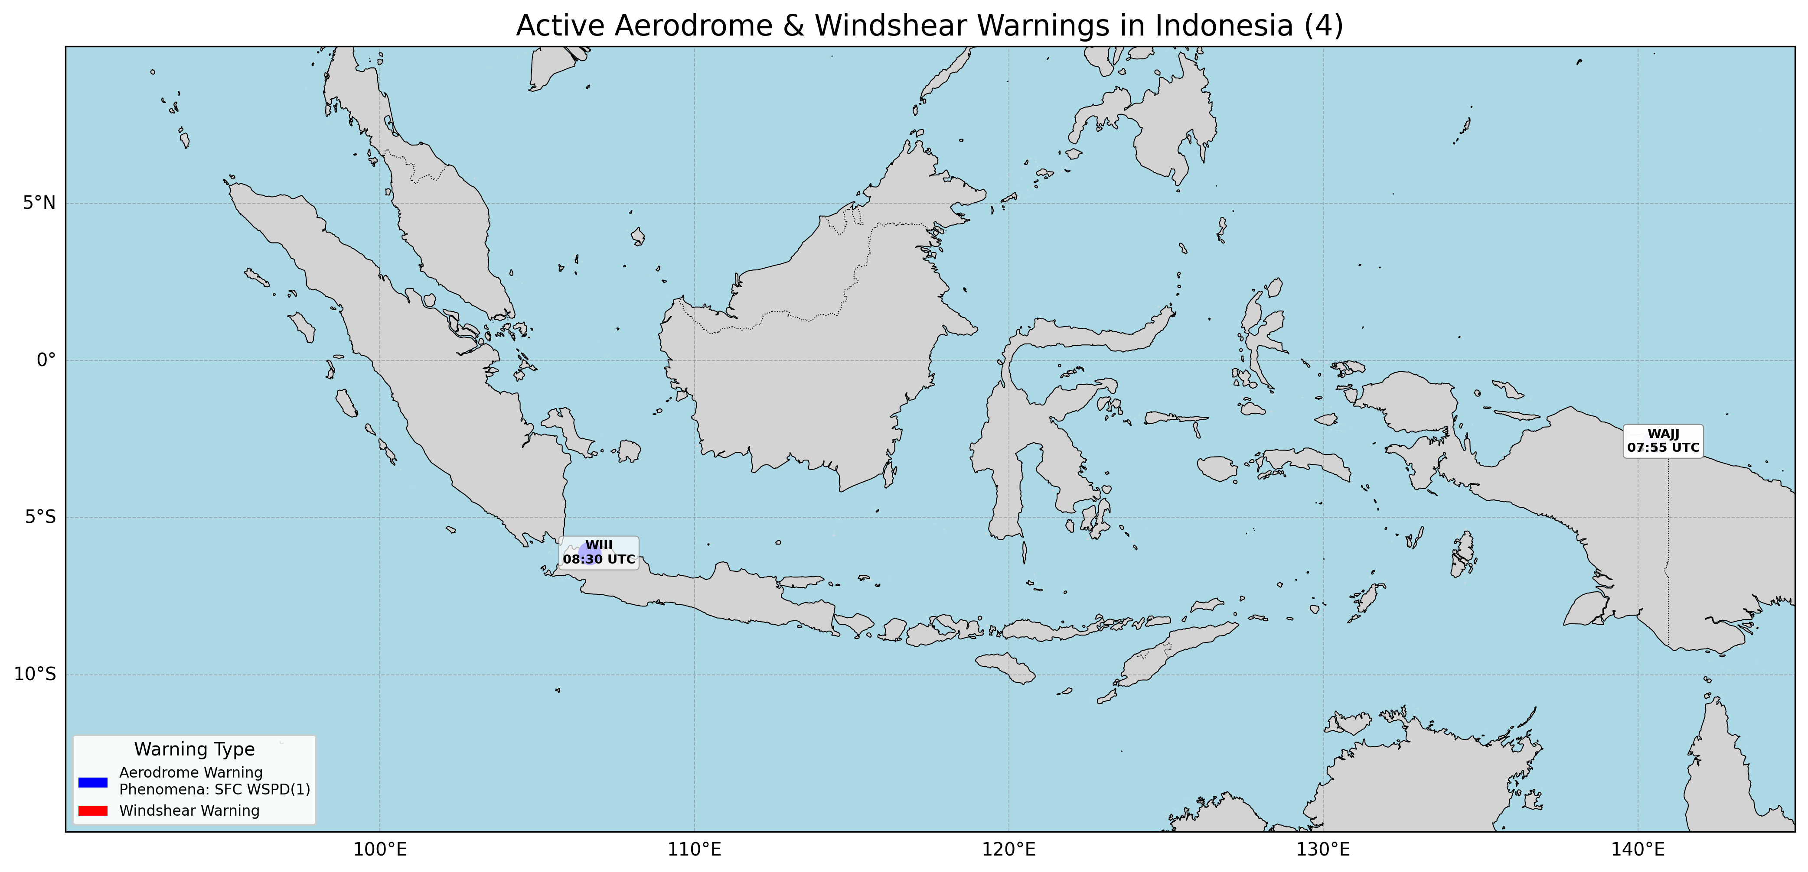
Warning Aktif 05 April 2025

Slide 25
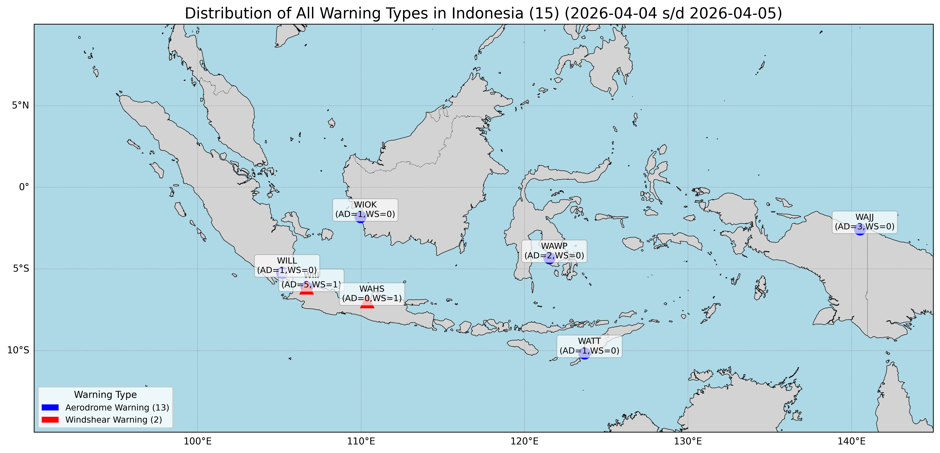
Warning selama 24 jam

Slide 26
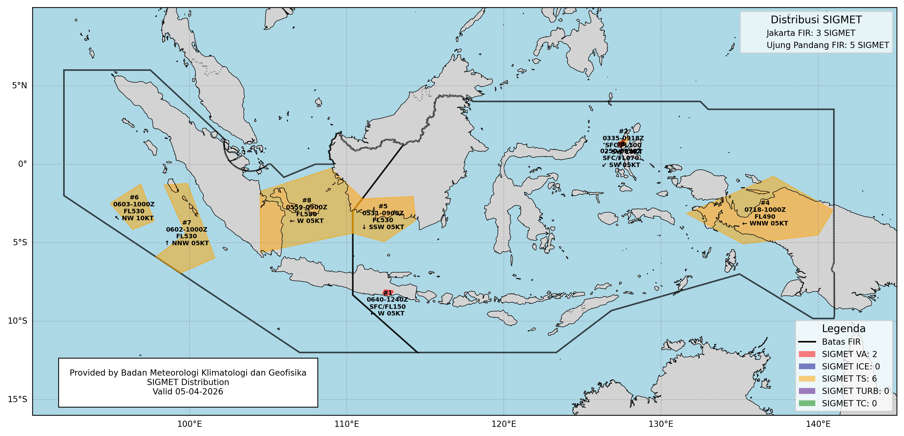
SIGMET 05 April 2025

Slide 27
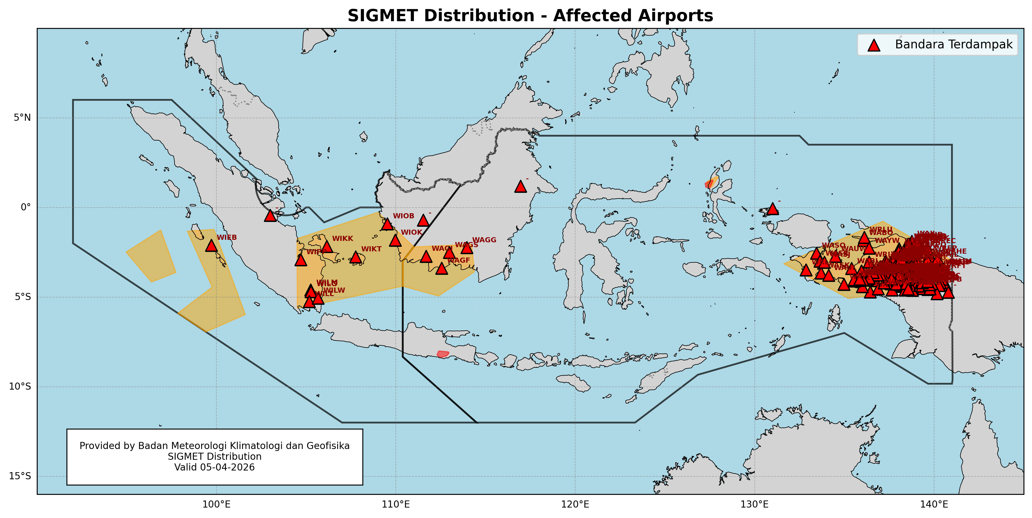
Distribusi SIGMET pada Bandara 05 April 2025

Slide 28
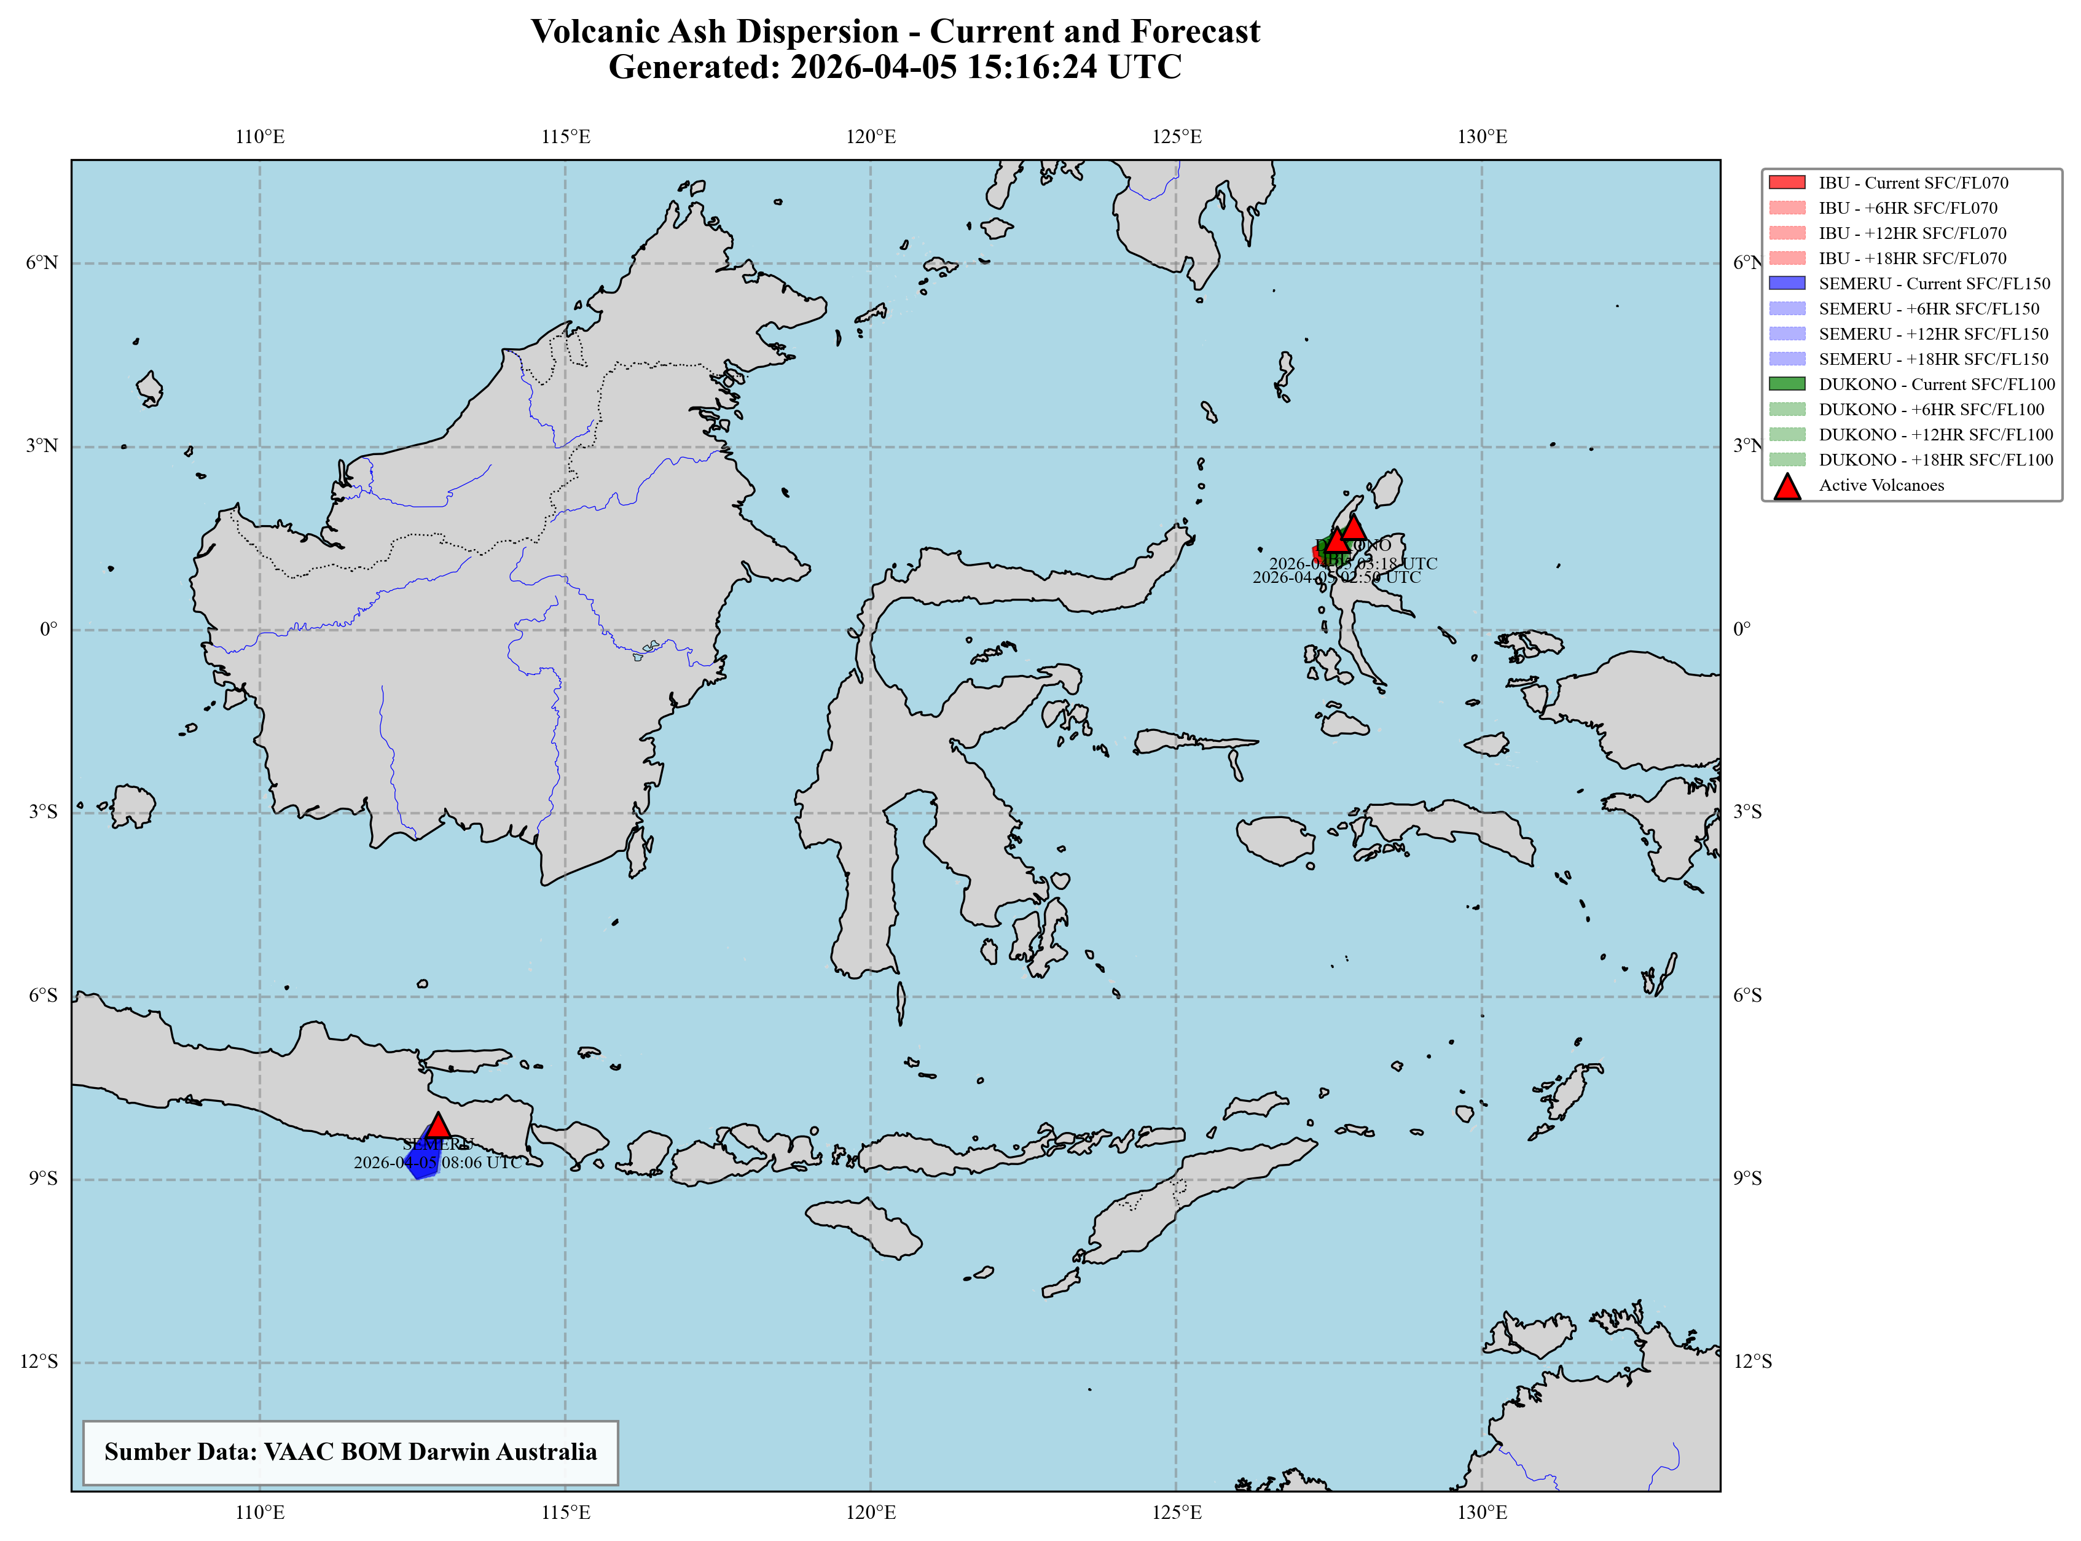
Advisory VAAC 05 April 2026

